Slide 1
TRKX - Trakx Token
White Paper

Slide 2
Table of Contents
Evolution not revolution
Market
Market observation
Sizeable market in crypto
Digital assets perception
Digital assets adoption
Trakx platform
CTIs - making the difference
Trakx - built for demanding investors
Trakx covers the whole value chain
A tech first approach
Simplified flows
Trakx product range
4. TRKX Token
TRKX token utility
Discount on fees
Referral program
Governance
Buyback & burn program
Distribution
Issuance schedule
Use of proceeds
Lifecycle
5. Meet Trakx
Meet Trakx business experts
Meet the senior tech team
Meet Trakx advisors
Our ecosystem of partners
6. Trakx Timeline
7. Disclaimers

Slide 3
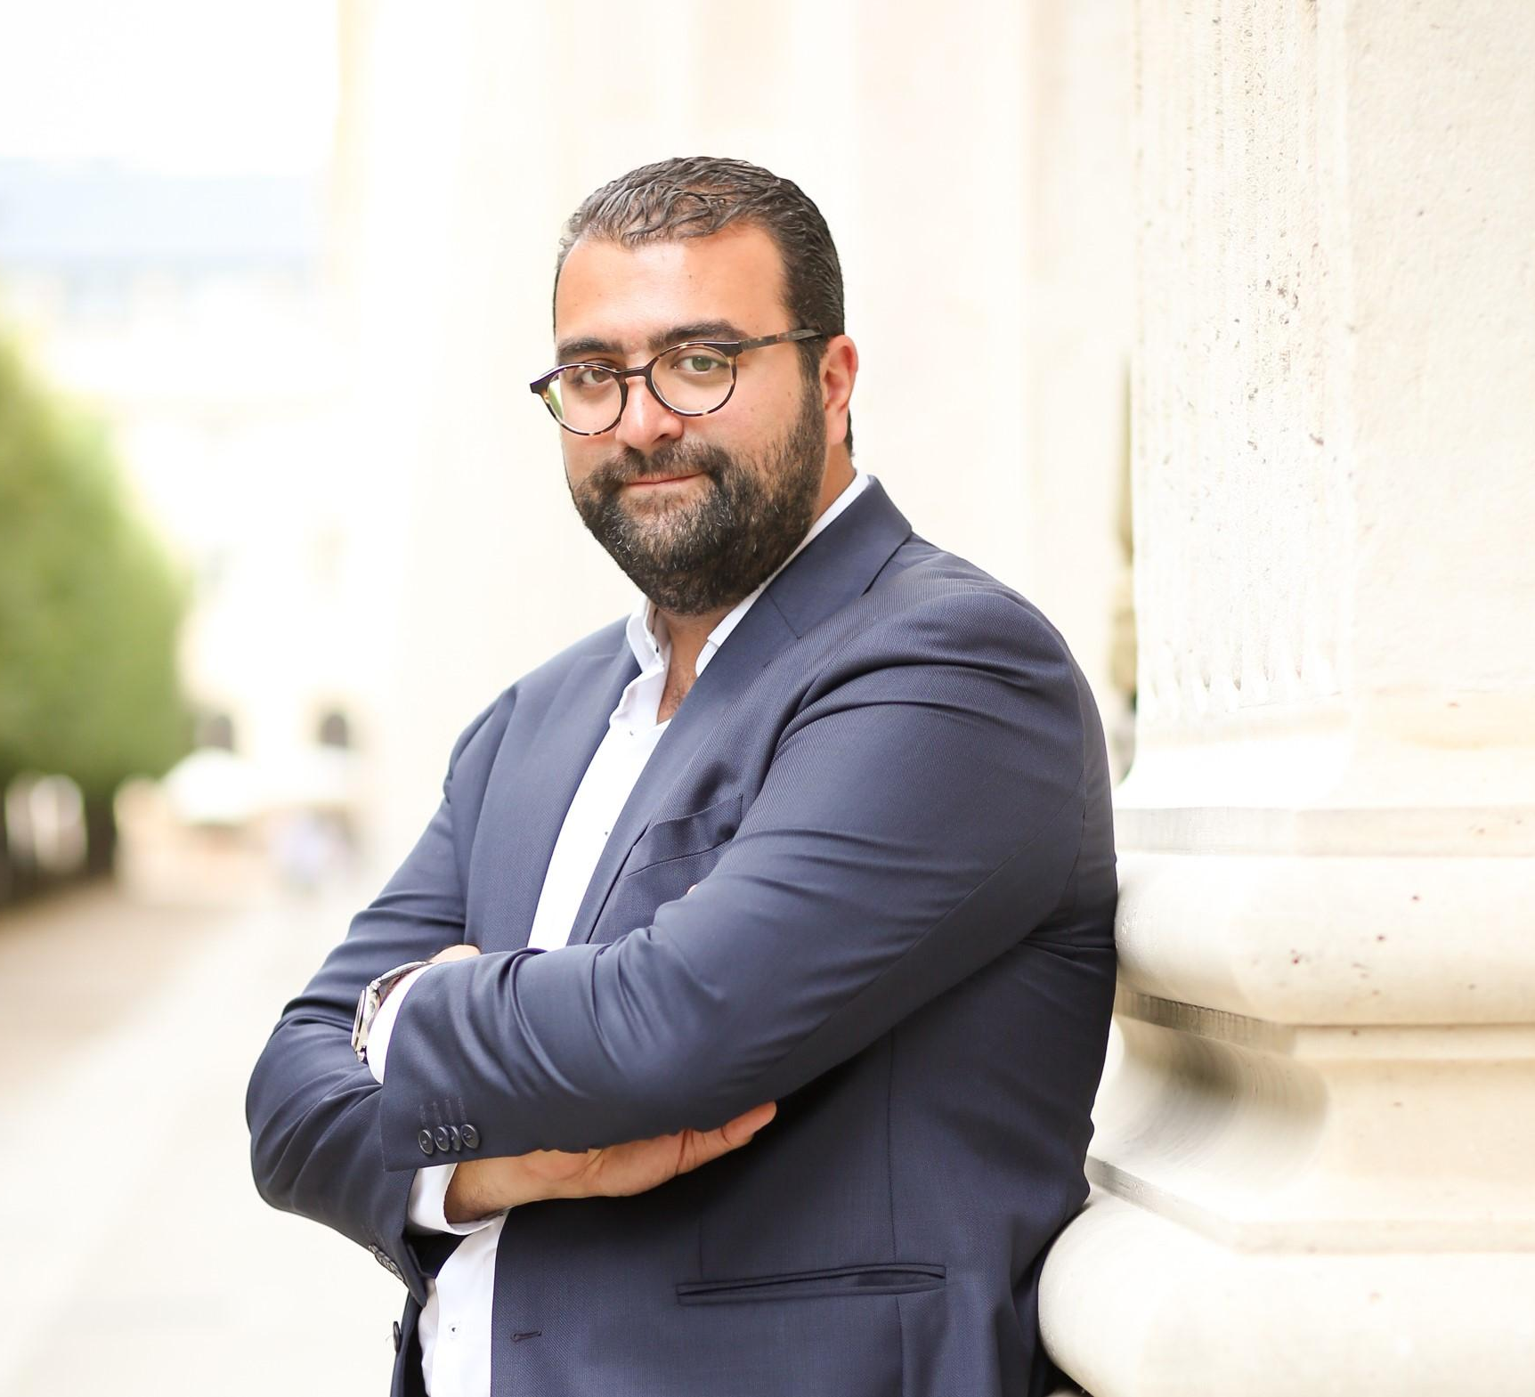
Evolution not revolution
When I started my career back in 2004, it was clear to me that finance was moving towards a world without borders. The internet’s ability to overcome geographic constraints meant that cultural and economic barriers were being eroded. Countries were increasingly connected both in terms of trade and capital flows. The world, as they say, was flat.
While global financial institutions, like those I used to work for, were well suited to this environment, it struck me as incongruous that money, the base layer of tradfi, had not witnessed a similar innovation.
Perhaps that is why, when I first started hearing about something called Bitcoin (while it was in its infancy), rather than simply dismissing it as a tech plaything, I intuitively grasped its potential.
Of course, having potential is one thing, but what really mattered was whether the public would ever embrace such a radical idea as a cryptocurrency. This is crucial because for anything to have value, it must be widely accepted. The jury was still out on this question when I began sharing ideas with a small group of people who would eventually become co-founders of Trakx.
Even now, several years later, a common statement often heard in crypto circles is it’s “still early”. But equally in some tangible sense it is also “too late”. Just like the genie, cryptocurrencies and blockchain technology cannot be put back in the bottle.

Slide 4
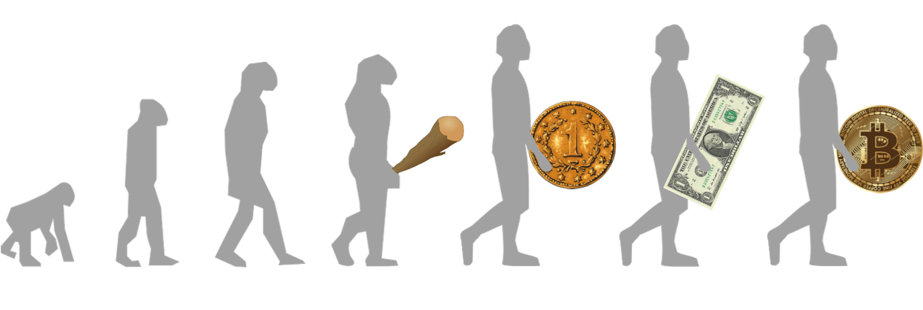
Evolution not revolution
The sector may still be young, but it’s expanding rapidly as more people are coming to realize the inherent benefit of having digital money in a form that relies on the power of maths and code to maintain its integrity.
There have been setbacks along the way as 2022 demonstrated. However, this was entirely attributable to the dubious practices and behaviours of individuals, not to the technology. These bad actors are being ejected from the industry and governments are in the process of providing greater legal/regulatory clarity. This is something we at Trakx welcome because it is unambiguously good for the long-run health of the ecosystem.
My co-founders and I have taken time and great care to put together a fantastic team of employees, advisors and developers from all over the globe - each one a seasoned tradfi or tech professional - to develop a platform that puts our clients first. Trakx is on a mission to truly democratise access to crypto by providing everyone with seamless, safe and strictly compliant access to crypto-indices.
Crypto is not a revolution, it is just the next stage in the evolution of money.
I am excited by what comes next and hope that you will share the same bold vision for the future of digital markets as the team does!
Welcome to Trakx...
Lionel

Slide 5
Market

Slide 6
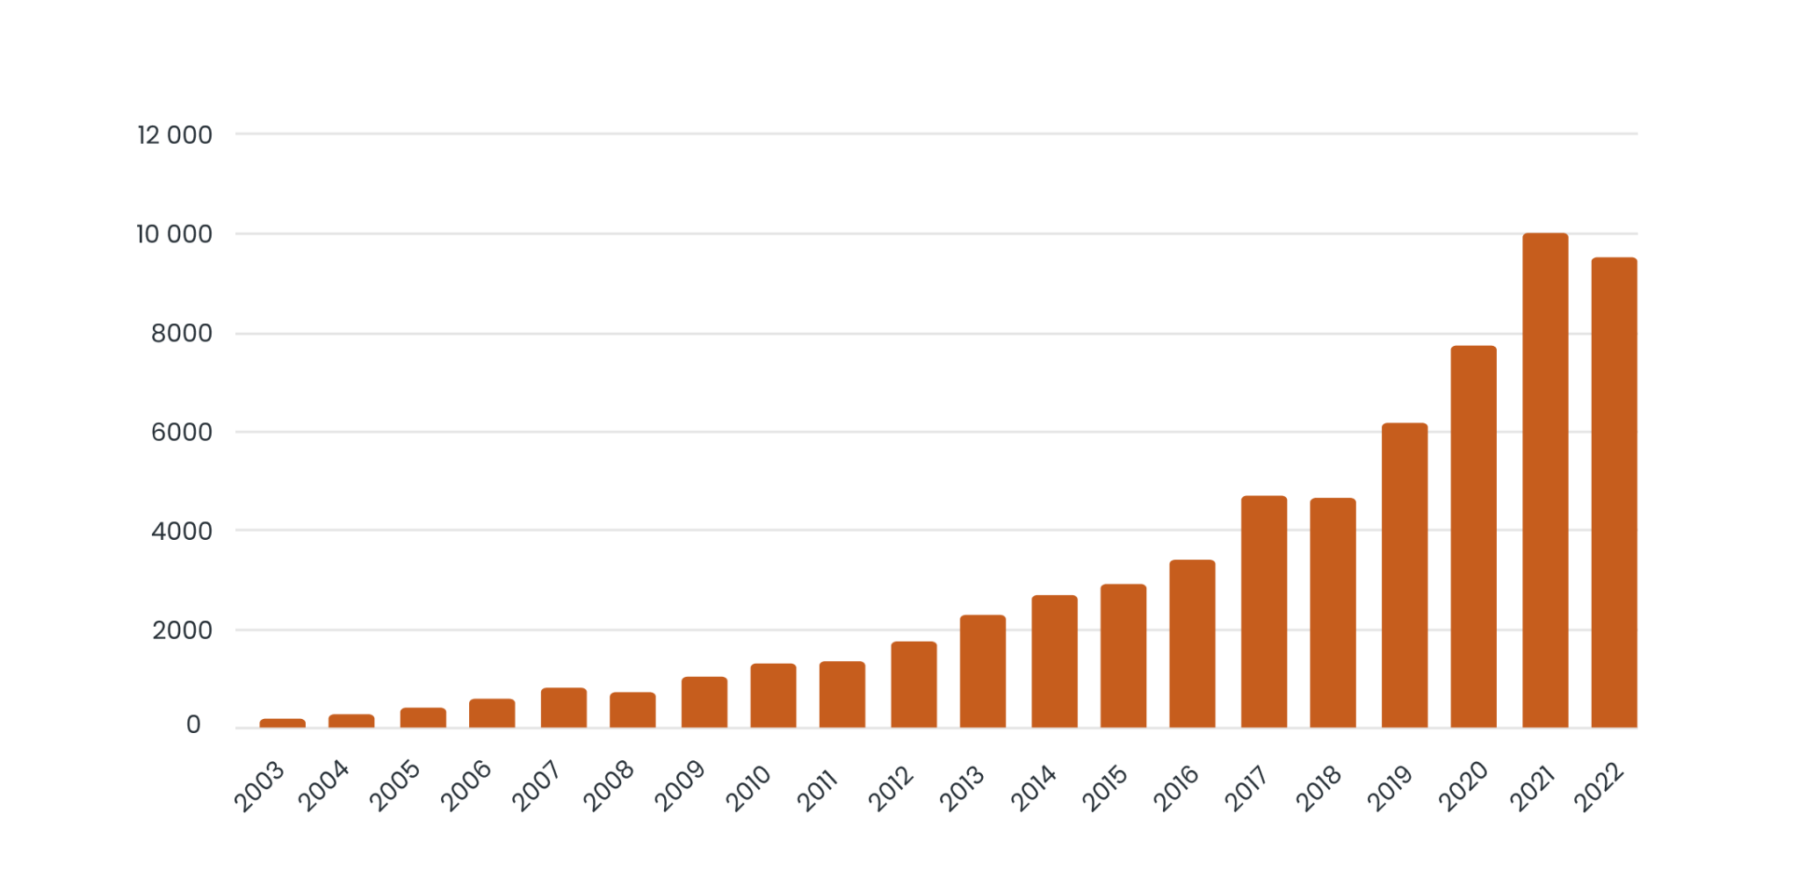
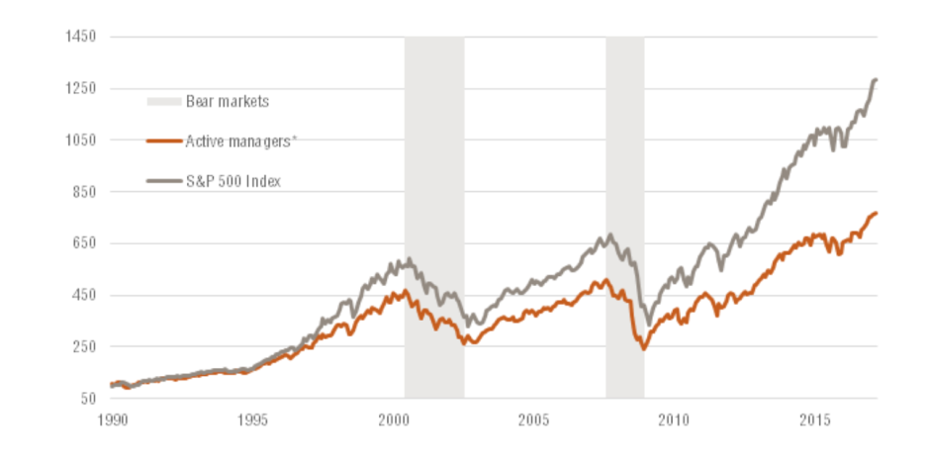
Market observation
The ETF market has shown strong momentum with AUM reaching $10 trillion from virtually zero 20 years ago
Development of assets of global exchange traded funds (ETFs)
from 2003 to 2022 (in billion U.S. dollars)
Source: Statista
Historically, passive products have outperformed active products
Active vs Passive: Relative Performance Index
Source: Bloomberg, Morningstar
Passive products are becoming the instruments of choice for market exposure because of their outperformance versus active products, along with lower costs and higher liquidity

Slide 7
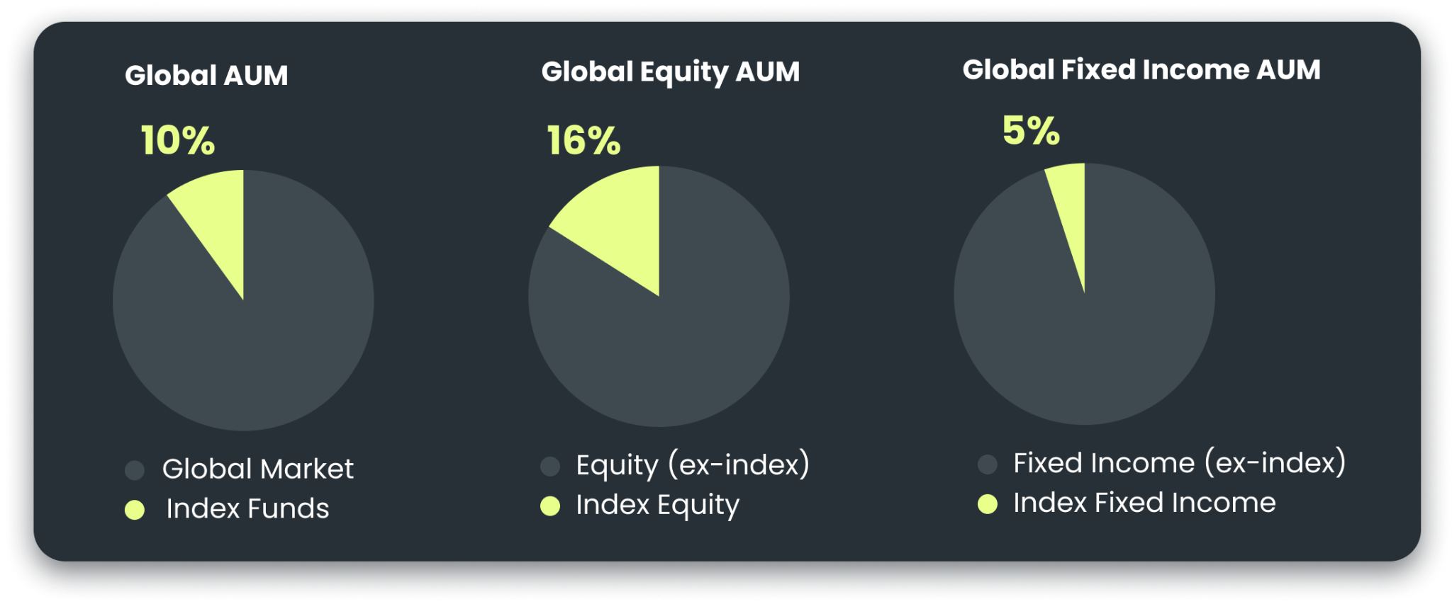

Sizeable market in crypto
To put things in context, the Global equities ETFs now represent over 15% of total Global equity assets, from almost zero 20 years ago
Index funds as a percentage of the market
Source: https://www.ishares.com/us/insights/all-about-etfs
Transposing this approach to crypto-assets implies an addressable market for crypto indices of ~$500bn, assuming that only 5% of the crypto AUMs are allocated to indices
Global AUM set to hit $150 trillion by 2025 Source: Pension and Investment
Crypto AuM could reach $10 trillion
(~6% of Global AUM)
Source: Bloomberg Crypto Outlook
Crypto Index Products
could reach $500bn+
(~5% of Crypto AUM)

Slide 8

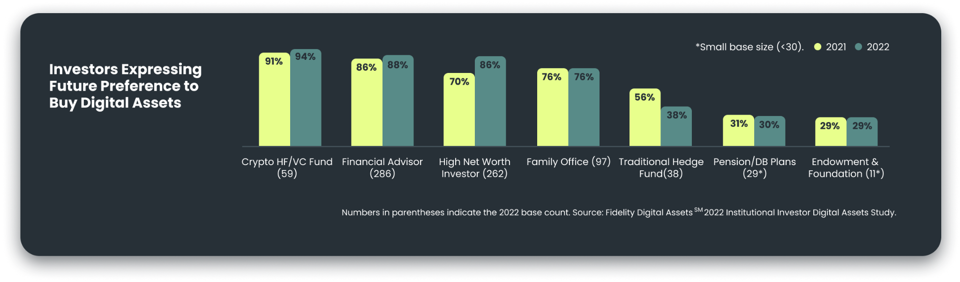
Digital assets perception
Despite the bear market in 2022, digital assets continue to benefit from increased adoption, improved perception, and more investment in Europe and the US.
The strong potential for growth, access to new technology, and diversification remain important decision factors.
Fidelity has made crypto investment accessible to all their clients
Blackrock has partnered with Coinbase to offer access to and custody of crypto assets
Invesco continues to expand its digital asset business and launch crypto ETFs
Trakx has launched its first ETP on the Top 10 Blockchains index
In favour of crypto
Total
Asia
Europe
U.S.
81%
84%
86%
74%
Source: Fidelity AssetsSM 2022 Institutional Investor Digital Assets Study
Private investors express their interest in buying crypto

Slide 9

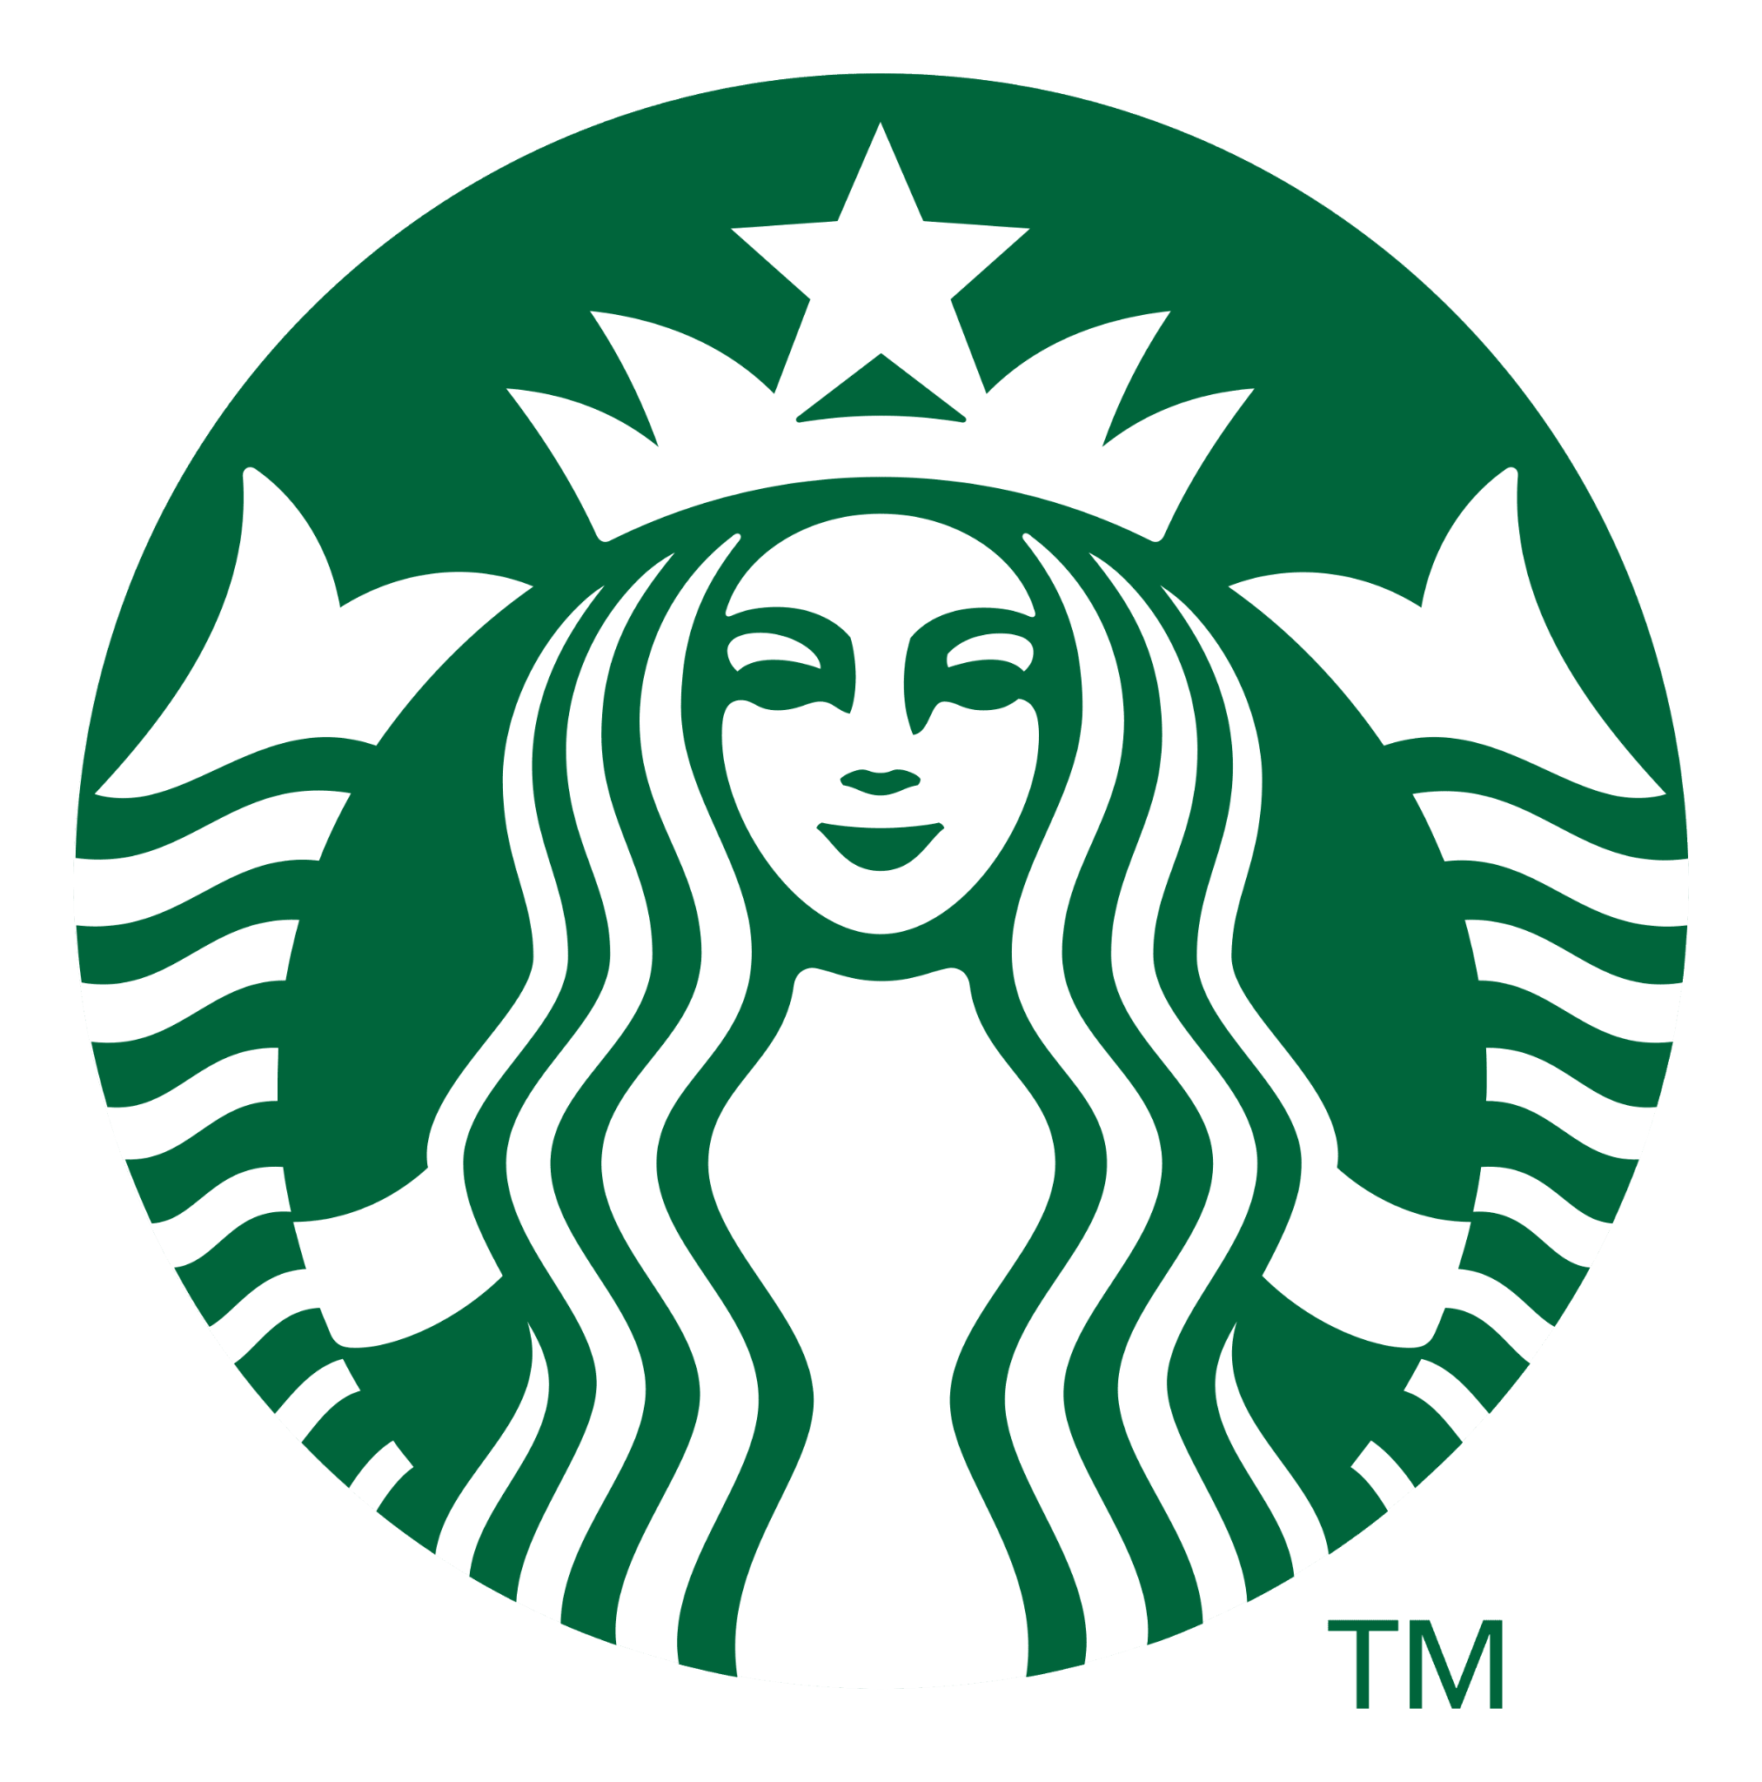



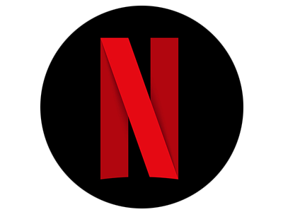






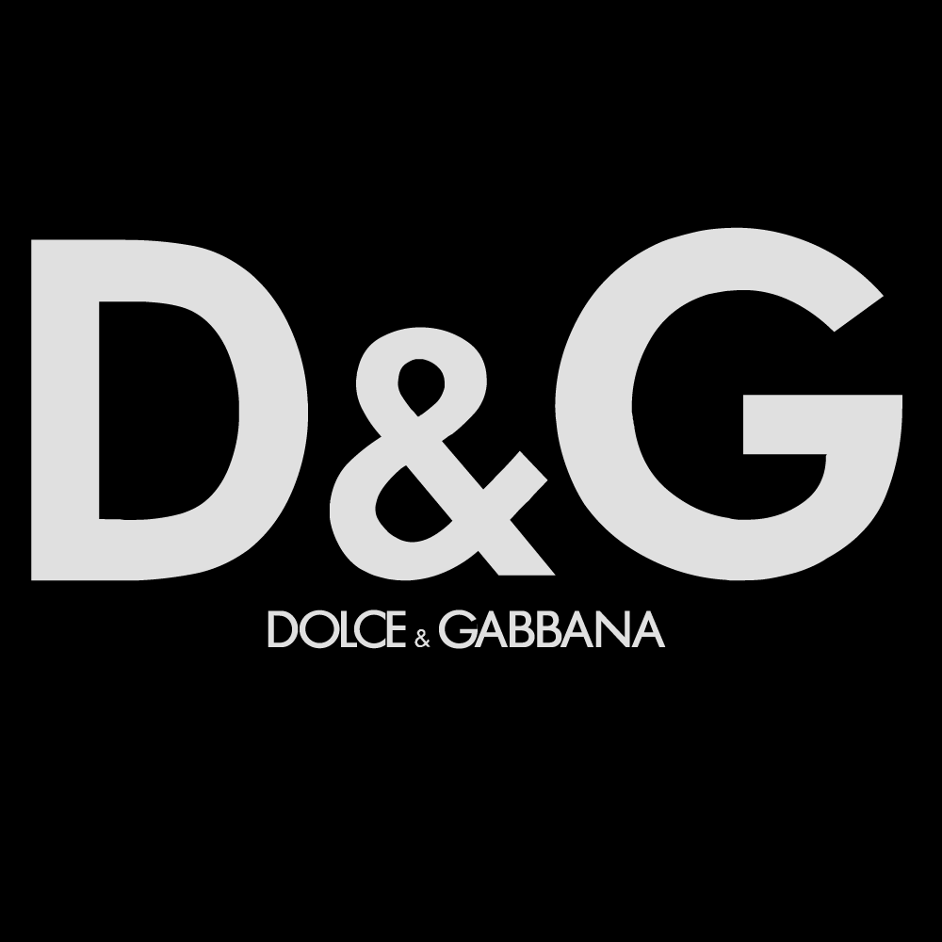











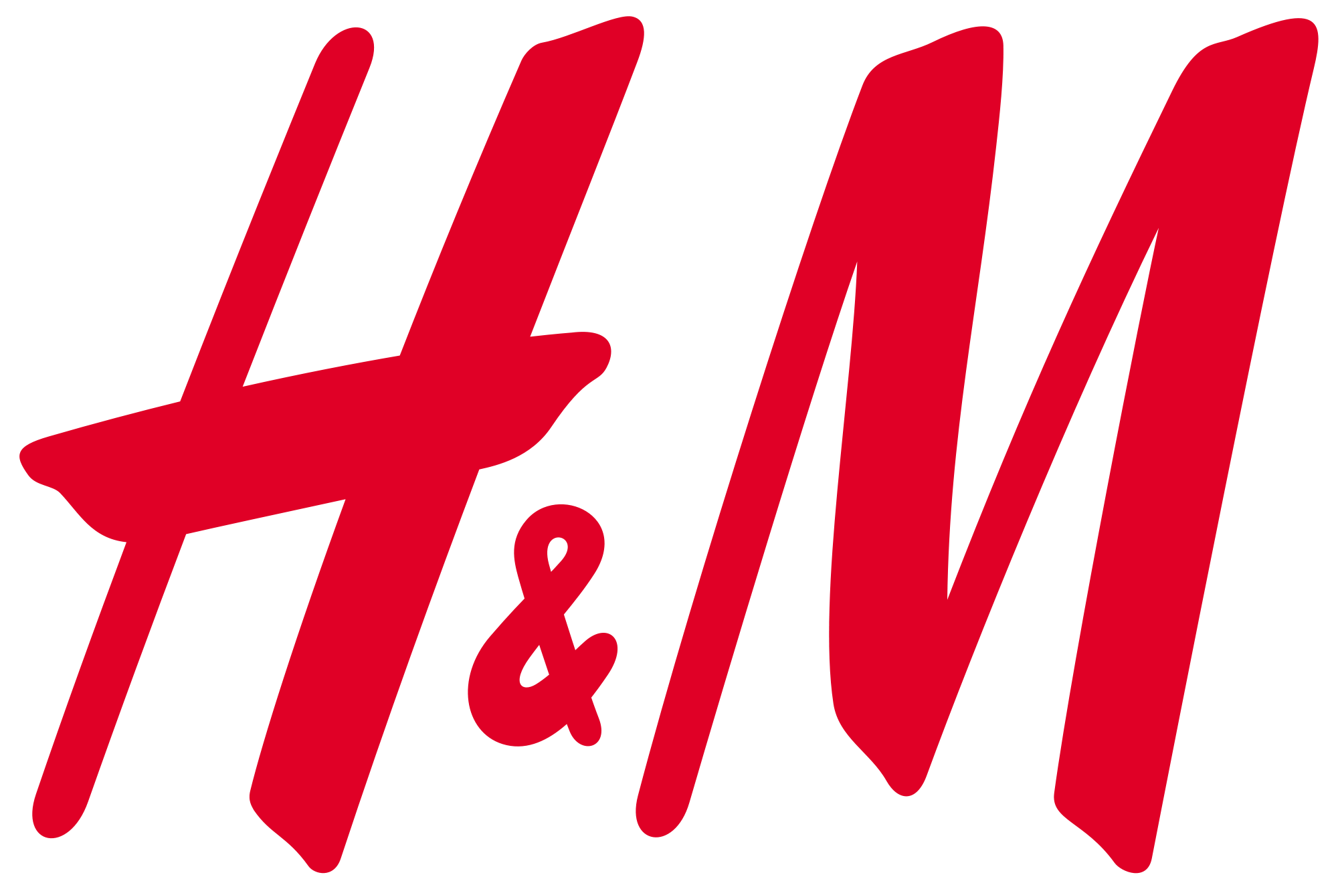





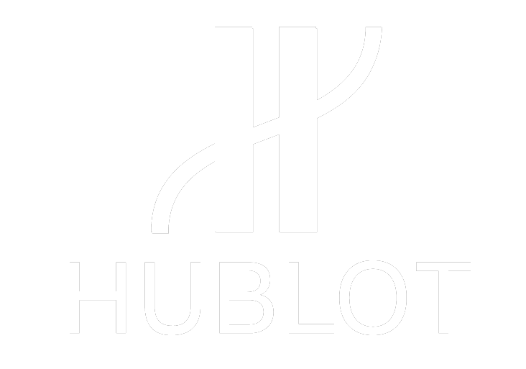

Digital assets adoption
Traditional brands coming to Web3 and NFTs
New use cases from the non-crypto space are creating more needs (tokenisation)
With around 10,000 active tokens and multiple use cases, we appreciate that navigating this new asset class can be overwhelming. At Trakx we offer a straightforward way to invest in thematic crypto baskets

Slide 10
Trakx platform

Slide 11
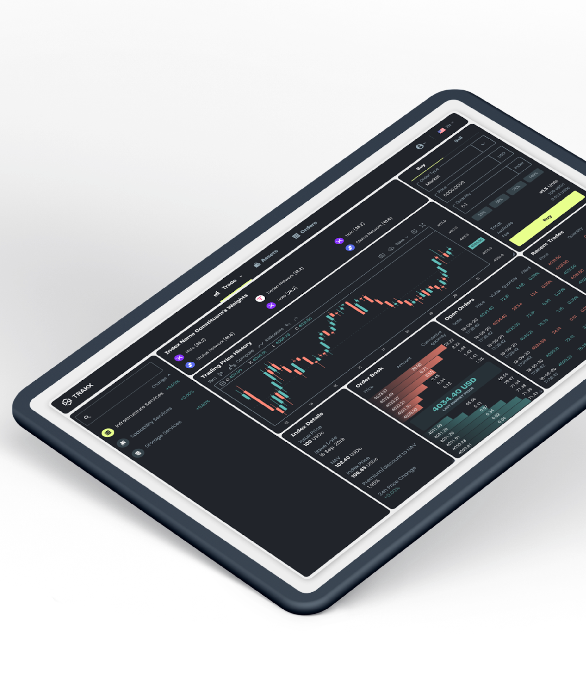
CTIs- Making the difference
Our mission
Trakx is the leading platform for crypto-index trading
Sophisticated & transparent index strategies
Trakx offers an array of advanced proprietary tradable instruments called Crypto Tradable Indices (CTIs)
CTIs track crypto asset indices that follow fixed and transparent rules and select the most liquid and relevant assets in each category
Publication of CTI token holdings, their weights and NAV are live intra-day and published daily on external media
Permanent liquidity
Trading flexibility, adapted to a fast moving environment (24/7/365)
Easy onboarding
KYC, AML following strict regulatory guidelines (French AMF registered)
Accessibility
CTIs are accessible through different channels, notably via Trakx’s dedicated trading platform

Slide 12


Trakx - built for demanding investors
Regulation
Regulation and compliance have always been central to Trakx’s ethos. Very early on, Trakx applied for and secured all the necessary regulatory approvals.
Trakx is registered with the French AMF & ACPR with the following licences:
Exchange
Custody
Fiat ↔ Crypto
Crypto ↔ Crypto
Crypto regulation is not static. New regulations will be introduced shortly (MiCA) and Trakx will ensure we remain compliant.
Low counterparty risk
The vast majority of assets are held by reputable crypto custodians, not by crypto exchanges
Assets are properly segregated
Strict rules to move assets
No lending of assets

Slide 13
Trakx covers the whole value chain
In-house index methodology and index management tool to offer only scalable products
Proprietary index management tool to manage the whole lifecycle of our products: creation, launch, listing, re-balancing…
Unbeatable time to market (a few hours to launch an index)
Trading bots: to make markets, source the underlying assets, move the assets with reputable custodians, and offer deep liquidity at the best possible price 24/7/365
Full control over the downstream: we can proactively test, launch, or retire CTIs to consistently stay current with market trends, ensuring that we always offer our clients the best market products
Owning our ecosystem allows us to 1) directly onboard clients (via our trading platform), 2) connect to various digital intermediaries and end-clients via APIs and 3) centralise all the flows which go through our products and reduce dependencies
Index design
Product launch
Liquidity management
Distribution via multiple channels (incl. Our exchange)

Slide 14
A tech first approach
Trakx’s automation and disintermediation reduces reliance on third parties and is more cost competitive
Liquidity
We apply a strict selection method to the underlying constituents for each of our CTIs (criteria based on market cap and daily volume)
Our trading bots are providing liquidity for all the trading pairs on the platform, ensuring sufficient depth on both the buy and sell sides
Index creation and management
In-house index methodology, construction, and management are open to third parties for externally managed CTIs via a user-friendly web UI or via programmable API calls
Automated hedging tool for best execution and to mitigate counterparty risk
Ability to move assets back and forth between exchanges and custodians
Full Integration with crypto exchanges, such as Binance, Kucoin, Coinbase…
Ability to customise default hedging behaviour and to hedge dynamic strategies automatically
Data quality
Data quality is crucial and our partnership with Kaiko ensures accurate and reliable live price data, with custom aggregation methods based on selected exchanges
Tech as-a-service solution is available through our white-labelling offering (please contact our sales team for details, sales@trakx.io)

Slide 15

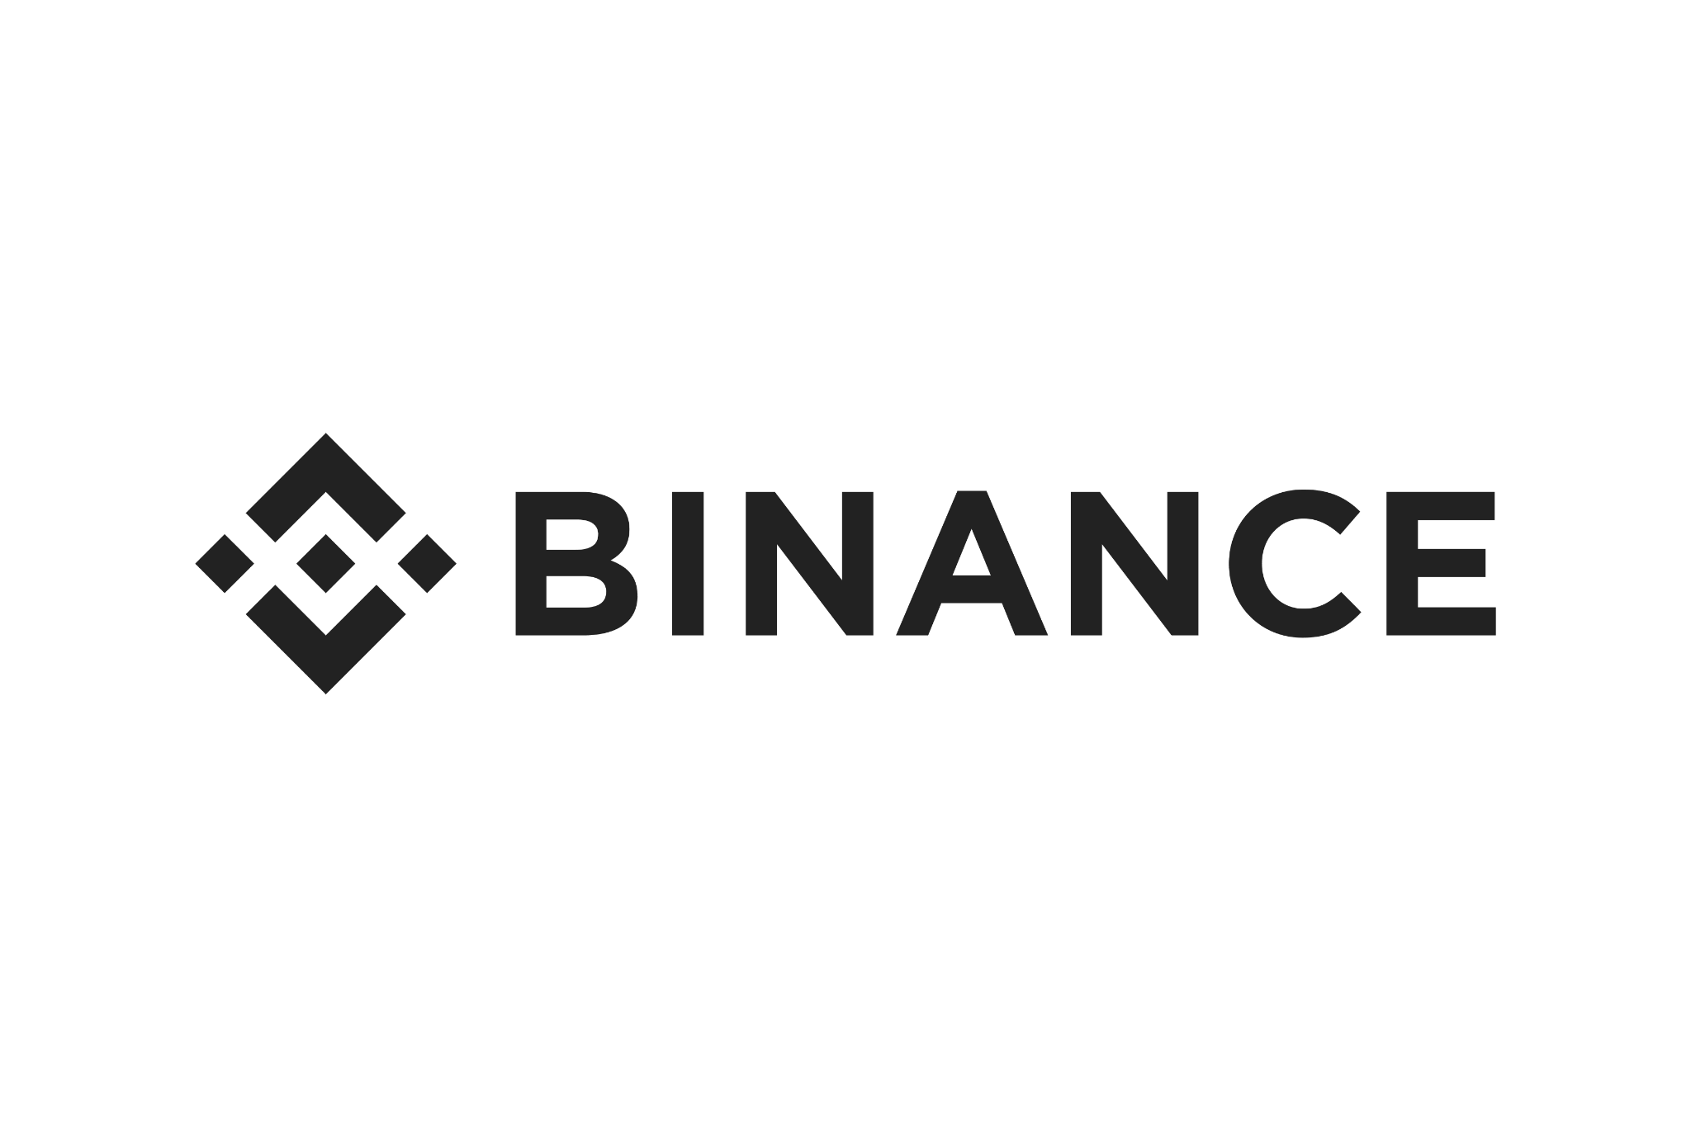
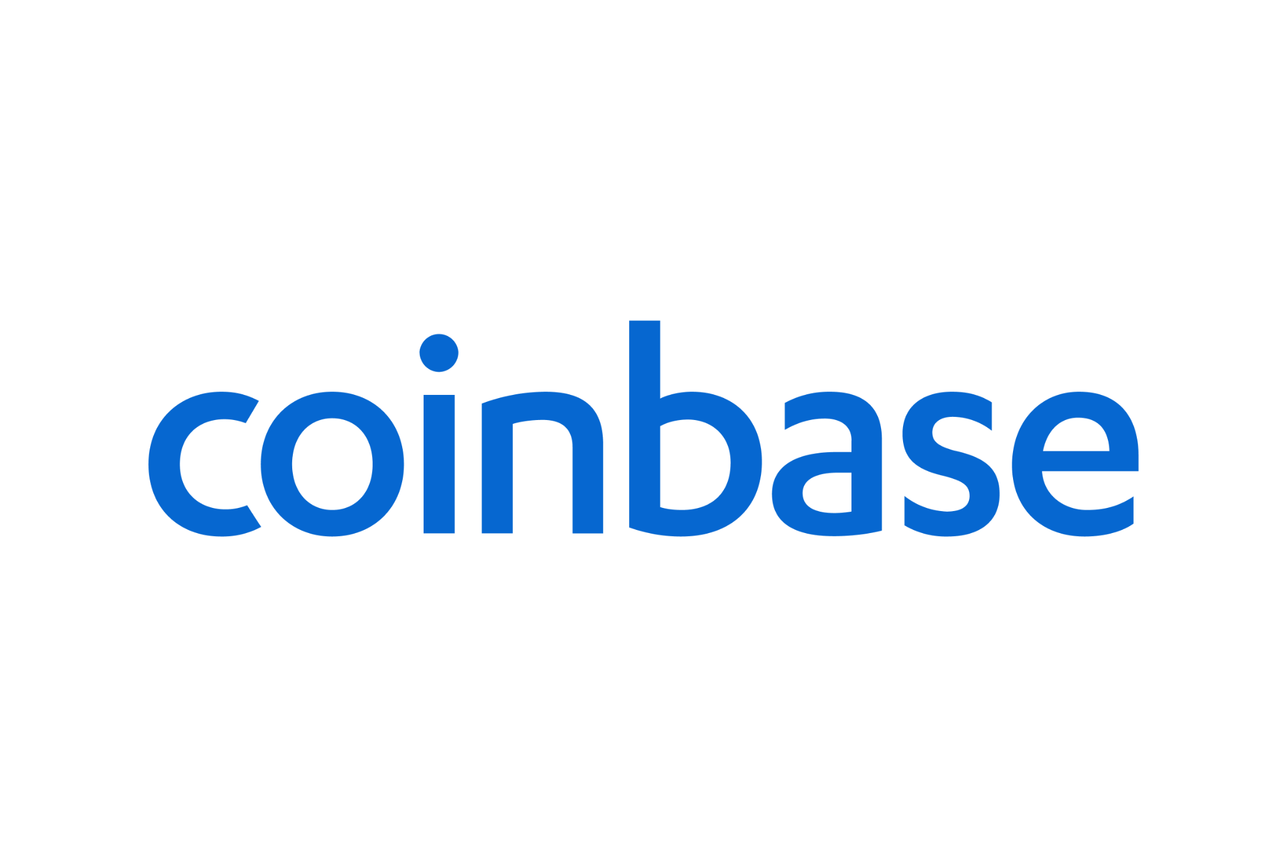
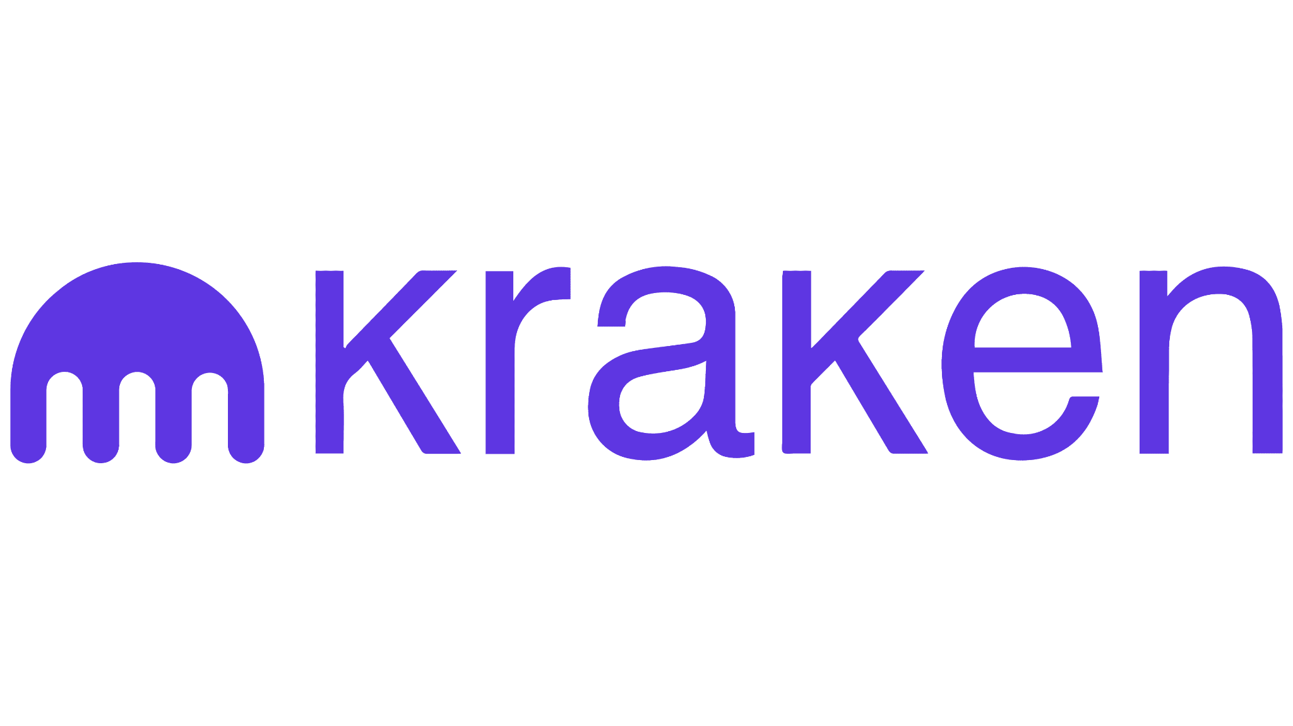


Simplified flows
Neobank
Broker
Dealer
Private Banker
Traditional
exchange
Client A Wallet
USDc CTI 1
100 USDc
Trakx Platform
Client B Wallet
USDc CTI 1
80 CTI 1
80 USDc
80 CTI 1
20 USDc
20 CTI 1
Trakx.io Index Manager
Market leading custodian to store private keys

Slide 16


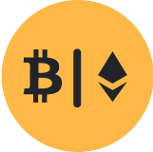














Trakx product range
Trakx offers CTIs for various investor profiles
Simple Access
Bitcoin
Bitcoin Ether 50/50
Top 10
Crypto
Thematic
ESG
Decentralised Exchanges
Top 10 DeFi
NFT Metaverse
Proof of
Stake
Top Blockchains
Centralised Exchanges
Lending
Interoperability
Smart Investing
Bitcoin Control 15
Digital Inflation Hedge
Diversifier
Notes:
Add phone icon and link to sales desk/blog

Slide 17




Trakx product range
Trakx offers CTIs for various investor profiles
Risk Profiled
Conservative
Balanced
Growth
Staked CTIs
Staked Matic
External CTIs
External indices and strategies are developed by third-parties and distributed on the Trakx platform
Notes:
Add phone icon and link to sales desk/blog

Slide 18
Trakx Token
(TRKX)

Slide 19
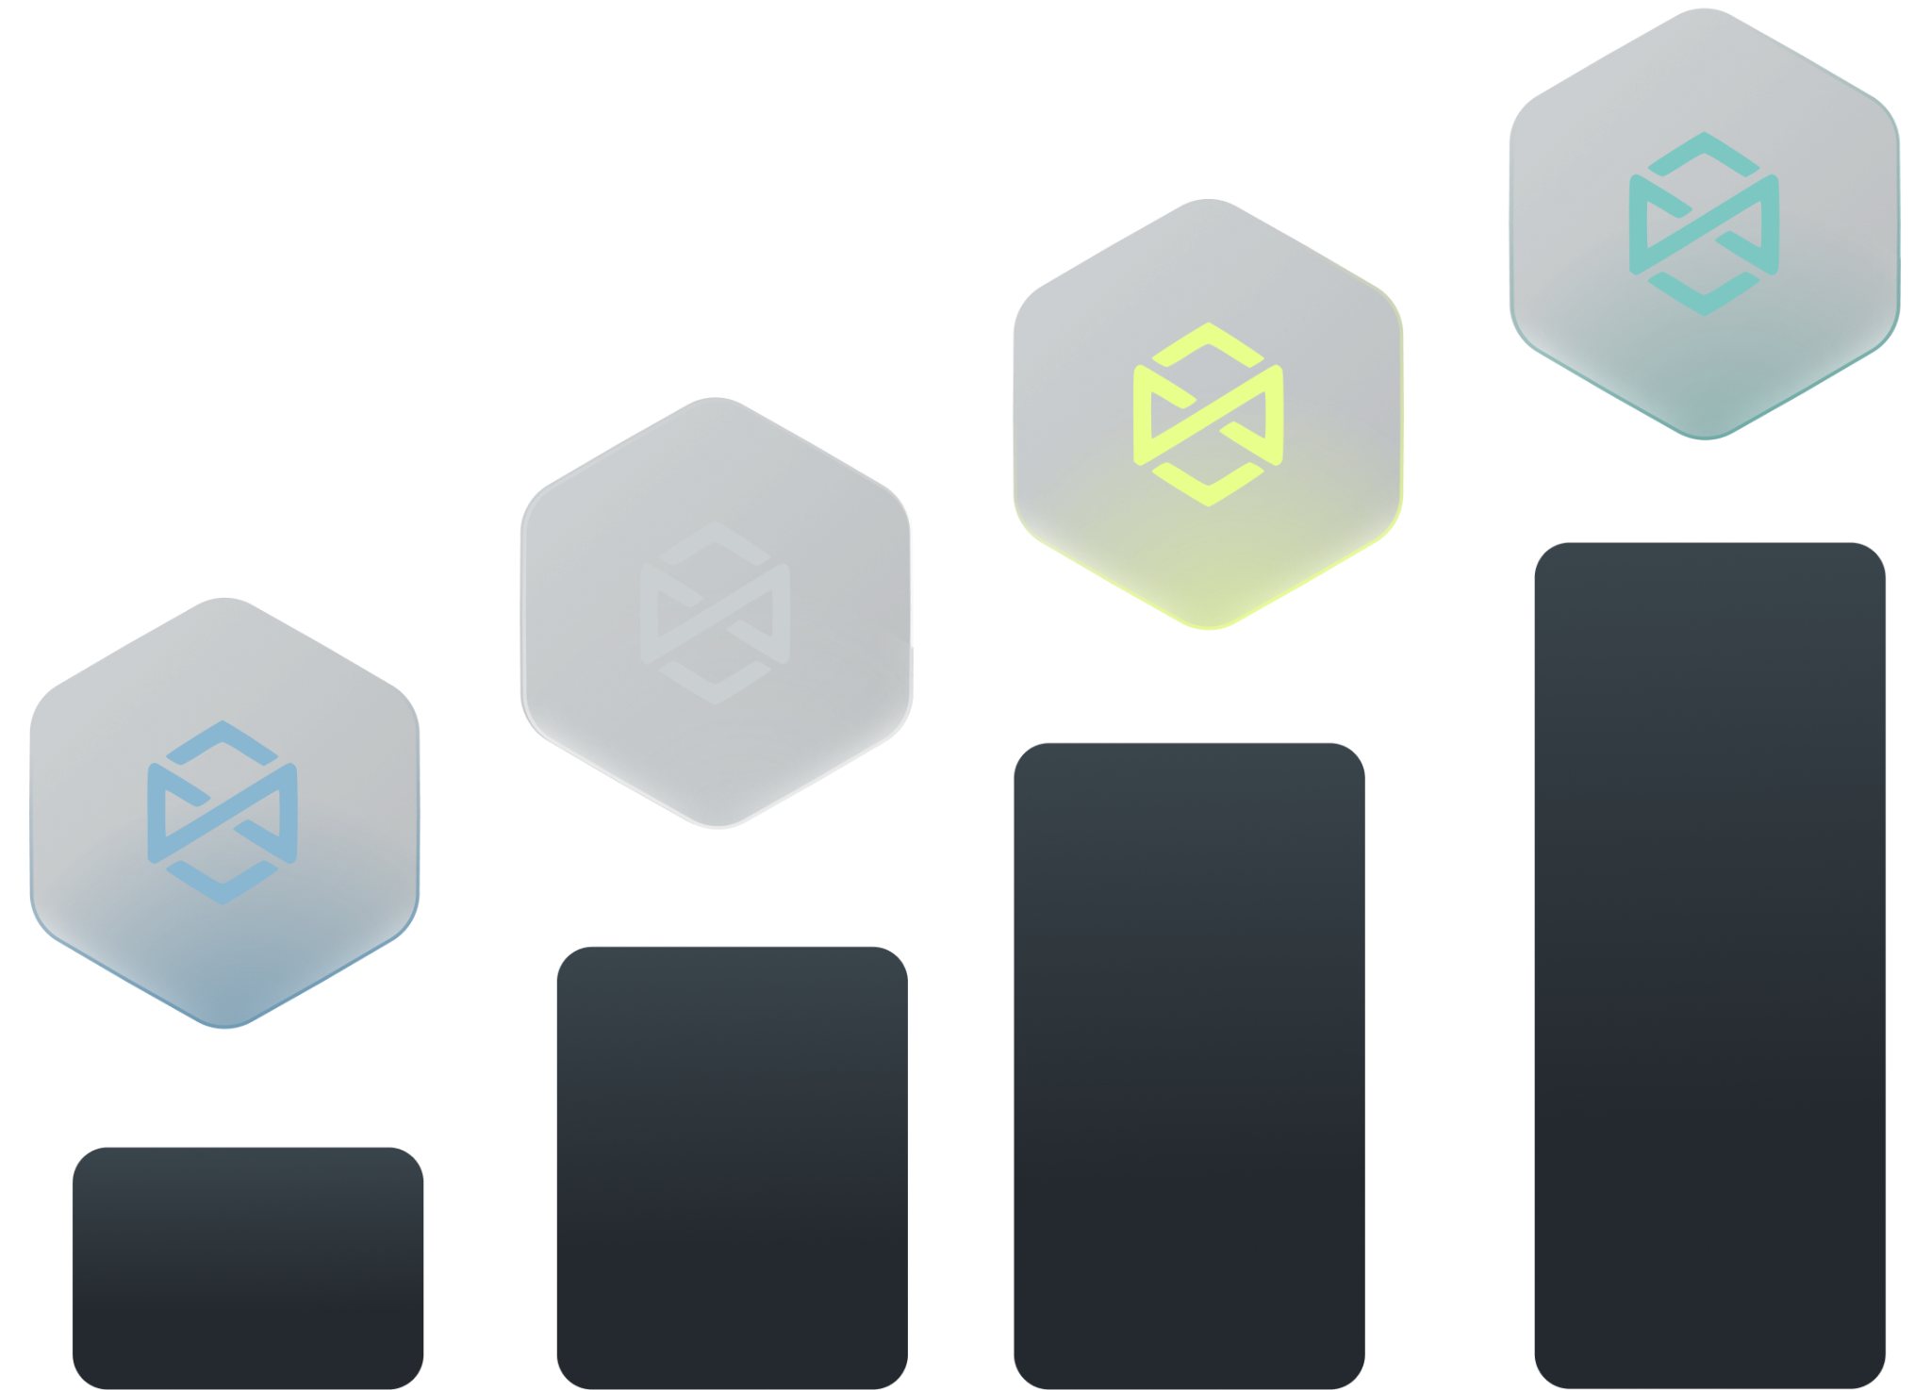
Trakx token utility
The Trakx token, TRKX, is a key tool to grow the Trakx retail ecosystem. It will provide its users with access to a wide range of advantages and benefits, including:
Discount programs: up to 50% discount on trading fees, depending upon the amount of TRKX tokens staked
Referral programs: from 20% to 35% fees redistributed for referrals, depending upon the amount of TRKX tokens staked
Grant programs: active community members will receive grants in TRKX tokens in exchange for specific actions & services (e.g. deposits and/or CTI purchases, trading competition…)
Governance: our community will get the opportunity to play an important role in key decisions, such as grant programs
Buyback and burn programs: 20% of the revenues derived from the retail trading business will be put in a vault and discretionarily used to buyback the TRKX tokens
Higher API trading rate
Other perks: priority access to new products (ie. alpha and bespoke products) & dedicated services (white glove, managed accounts…)

Slide 20

Discount on fees
The Trakx discount program is composed of an eight tier system based on the Trakx token holdings and gives up to 50% trading discount.
The fee schedule depends on the total of TRKX traded volume during the preceding 30-day period (in USD equivalent). Thus, the benefits start at the end of the 30-day holding period and recalibrate every 30 days.
Tier | TRKX staked (USD equivalent)* | Discount on Taker & Maker Fees
Regular 1 | $0 | 0%
Regular 2 | > $100 | 5%
Regular 3 | > $1,000 | 10%
Regular 4 | > $10,000 | 20%
Vip 1 | > $50,000 | 25%
VIP 2 | > $200,000 | 30%
VIP 3 | > $1,000,000 | 40%
VIP 4 | > $5,000,000 | 50%
On the basis of 1 TRKX= 0.06 USD

Slide 21
Referral program
Up to 35% fee redistribution
If a new user registers using a referee's unique referral code, the referee will receive 20%–35% of their fees, and the referred user will receive a 5% refund. The referee will benefit from the fee redistribution for one month only.
Level | TRKX staked (USD equivalent)* | Fee redistribution rates
Level 1 | $0 | 20%
Level 2 | > $250 | 22%
Level 3 | > $500 | 24%
Level 4 | > $1,000 | 26%
Level 5 | > $10,000 | 28%
Level 6 | > $50,000 | 30%
Level 7 | > $250,000 | 32%
Level 8 | > $1,000,000 | 35%
On the basis of 1 TRKX=0.06 USD

Slide 22

Governance
Along with economic benefits, the TRKX token will play an important role in the Trakx ecosystem governance.
TRKX token holders will have the right to vote on key proposals, such as incentive programs, grant programs, allocation of TRKX tokens, allocation of fees generated by the platform.
Holders will be able to delegate their tokens to the most active community members.

Slide 23
Buyback & burn program
Through our buyback and burn program, Trakx is committed to supporting both the value of its token and the project’s long-term success.
20% of the revenue derived from the retail trading business will be transferred into a vault, comprising both stablecoins and TRKX tokens
This vault will be used to buyback or sell TRKX tokens on the markets when required. This model aims at ensuring that the TRKX public price is in line with the value perceived by long-term TRKX holders
Buyback programs will not occur on a recurring basis. Like for listed equities, internal research will be required to assess the value for long-term holders and the timing of buyback programs

Slide 24
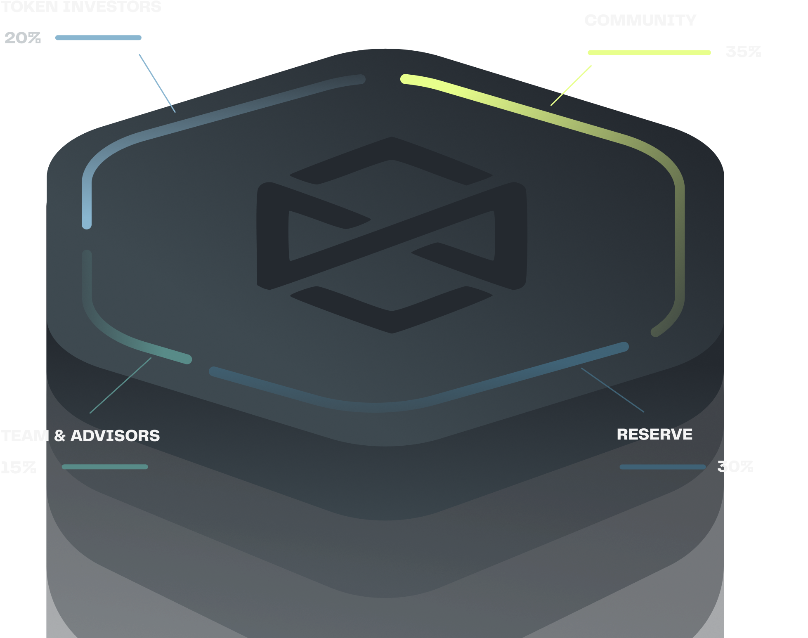
TRKX distribution
The TRKX token distribution follows industry best practices
Our community will receive the largest share and will be incentivized and rewarded with targeted airdrops, discount & referral programs

Slide 25
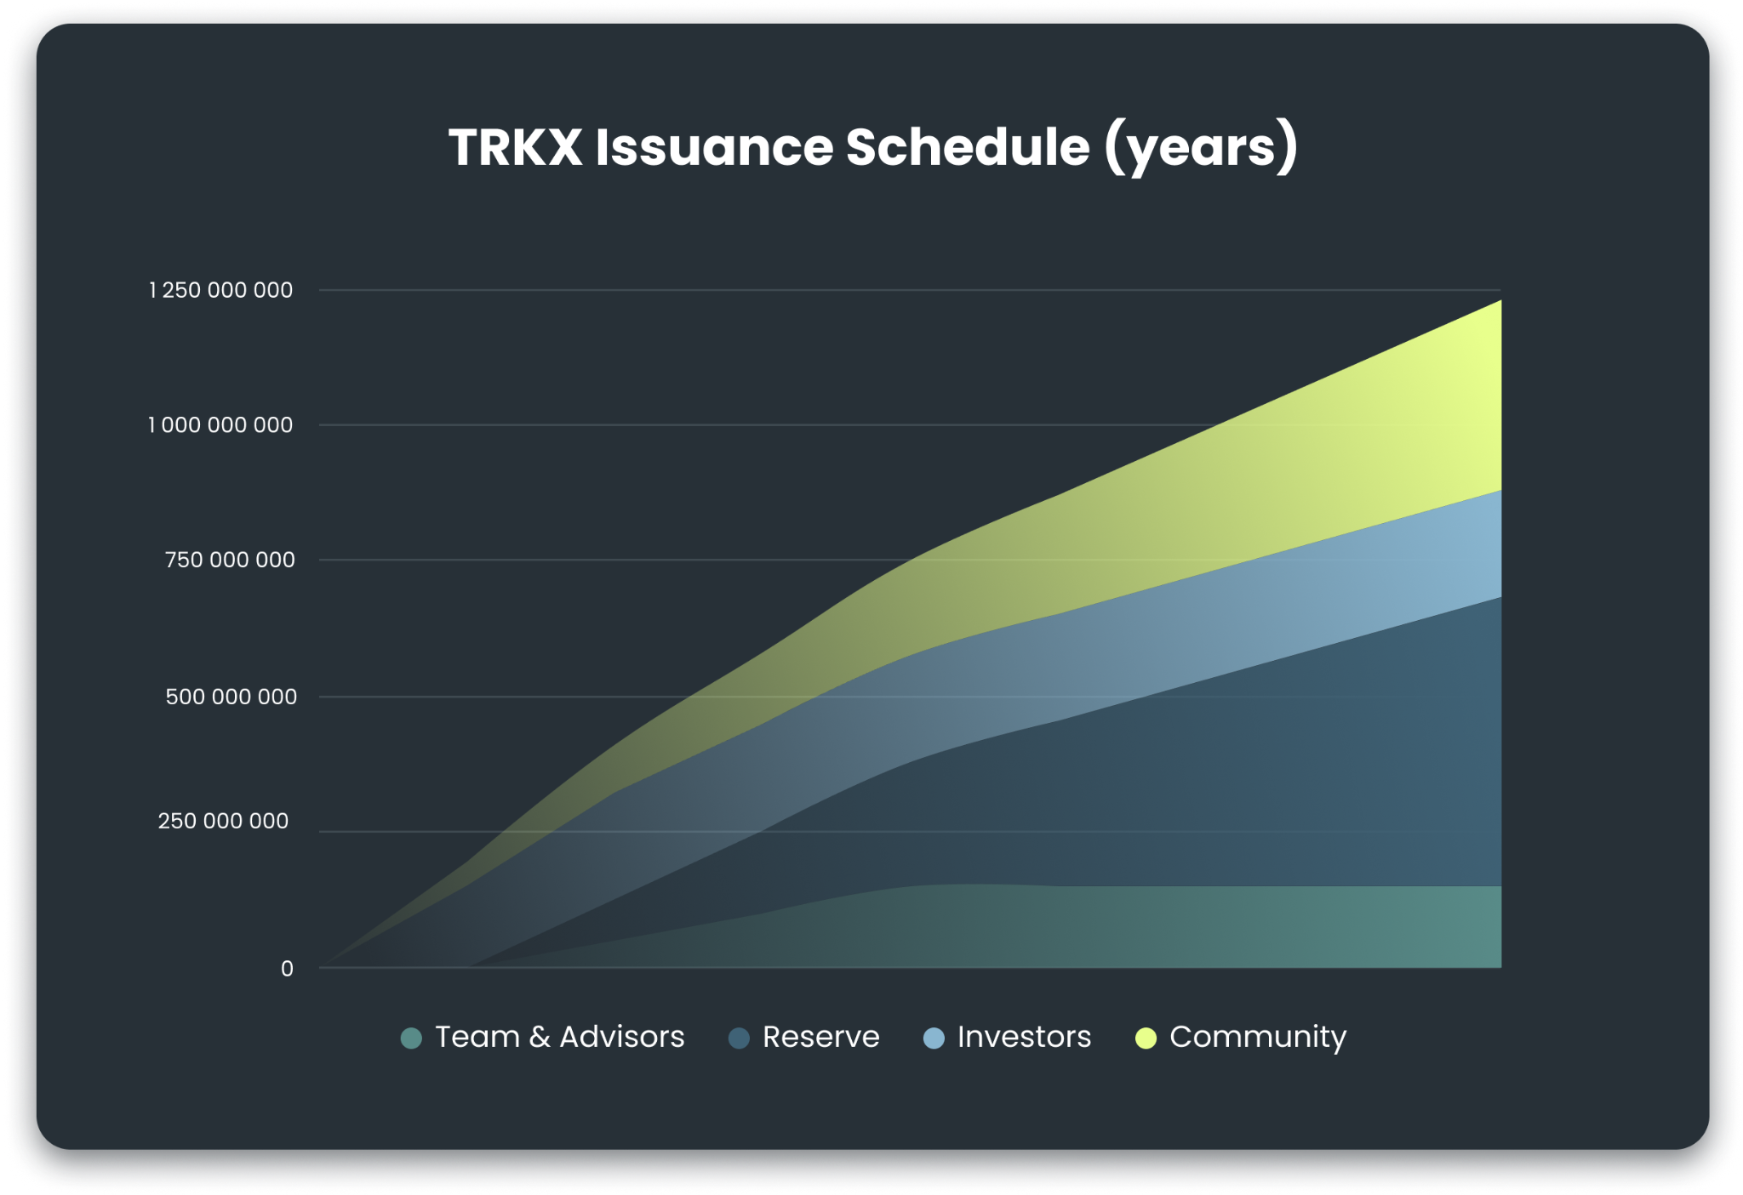
TRKX issuance schedule
To align individual interests with the long term success of Trakx, our team members will undergo the longest vesting period of 36 months
Vesting from investors in the private sale will range from 6 to 18 months
Tokens will be gradually distributed to the community over 8 years, ensuring a smooth project decentralization

Slide 26
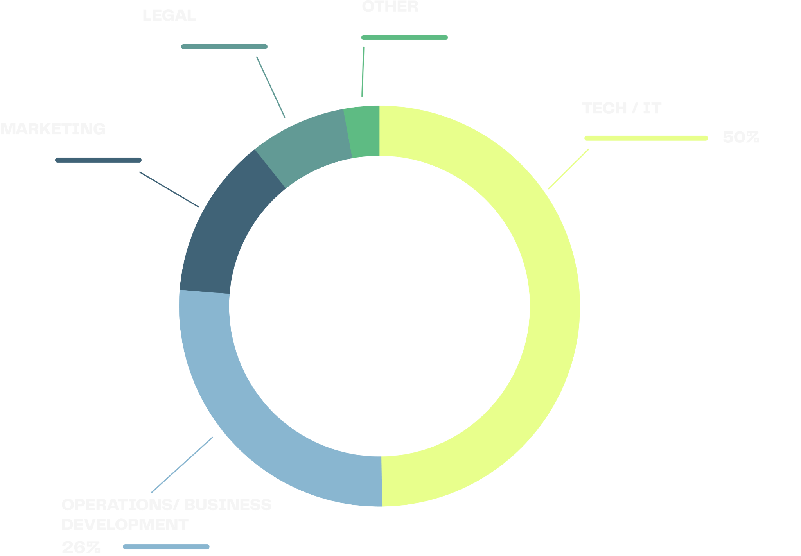

TRKX token sales use of proceeds

Slide 27
TRKX lifecycle
Trakx team is committed to offer a best-in-class token strategy through the TRKX lifecycle, in line with industry standards:
Listing: making TRKX available on secondary markets (both centralized & decentralized exchanges) – talks already engaged with reputable centralized exchanges
OTC desk: opening a dedicated desk for large over-the-counter trades
Market-making: ensuring the TRKX token is liquid and spreads are low on secondary markets – talks already engaged with external market-makers
Buyback & burn Model: 20% of trading fees will be transferred into a vault comprising both of stablecoins and TRKX tokens. This vault will be used to buyback or sell TRKX tokens on the market when required. This model will aim at ensuring that the TRKX public price is in line with the value perceived by long-term TRKX holders

Slide 28
Meet Trakx

Slide 29

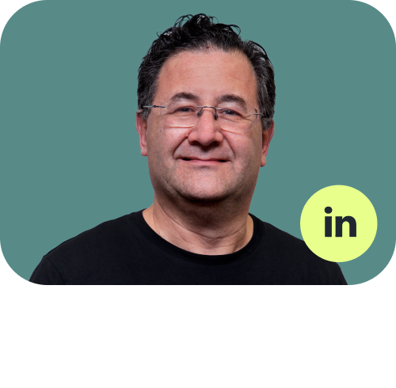

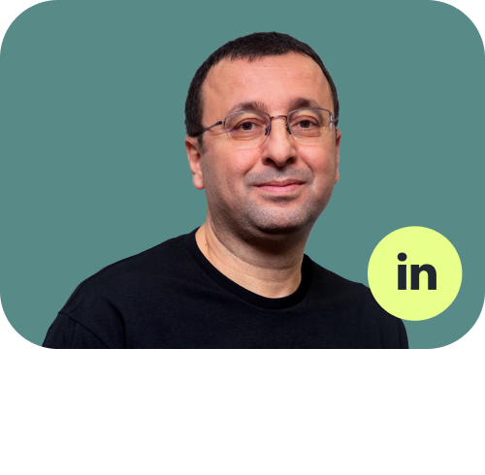
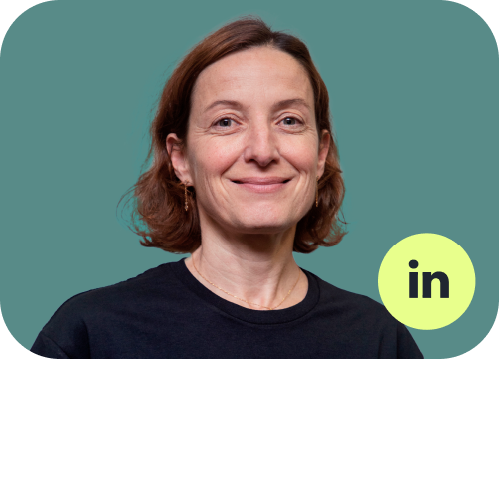
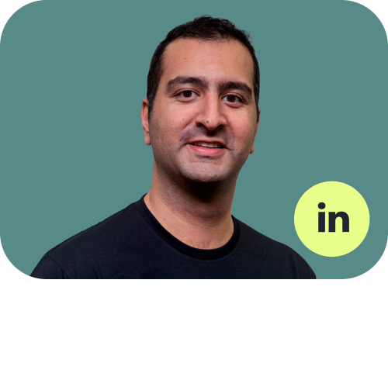

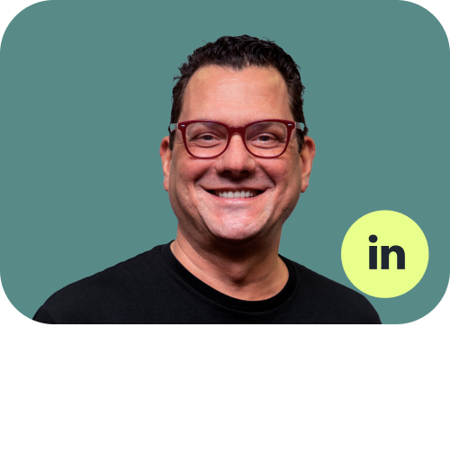
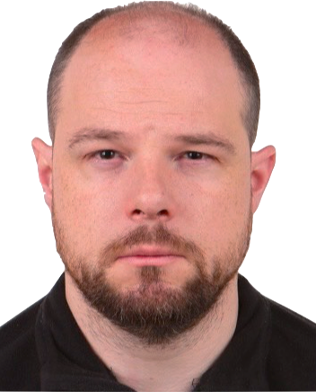

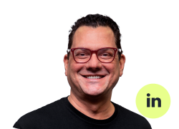
Meet Trakx business experts
Lionel Rebibo
Laurent Barocas
Alexander Jansen
CEO - CO Founder
Co-founder and Chief
Client Officer
Global Head of Sales
Mohamed Yangui
Caroline Jacquard
Gary Rebibo
Head of Product Structuring
Marketing and Communication
Co-founder and Chief
Marketing Officer
Ryan Shea
Peter Stamas
Yann Le Floch
Digital Money Banker
Crypto economist
Head of US Operations and Business Development

Slide 30
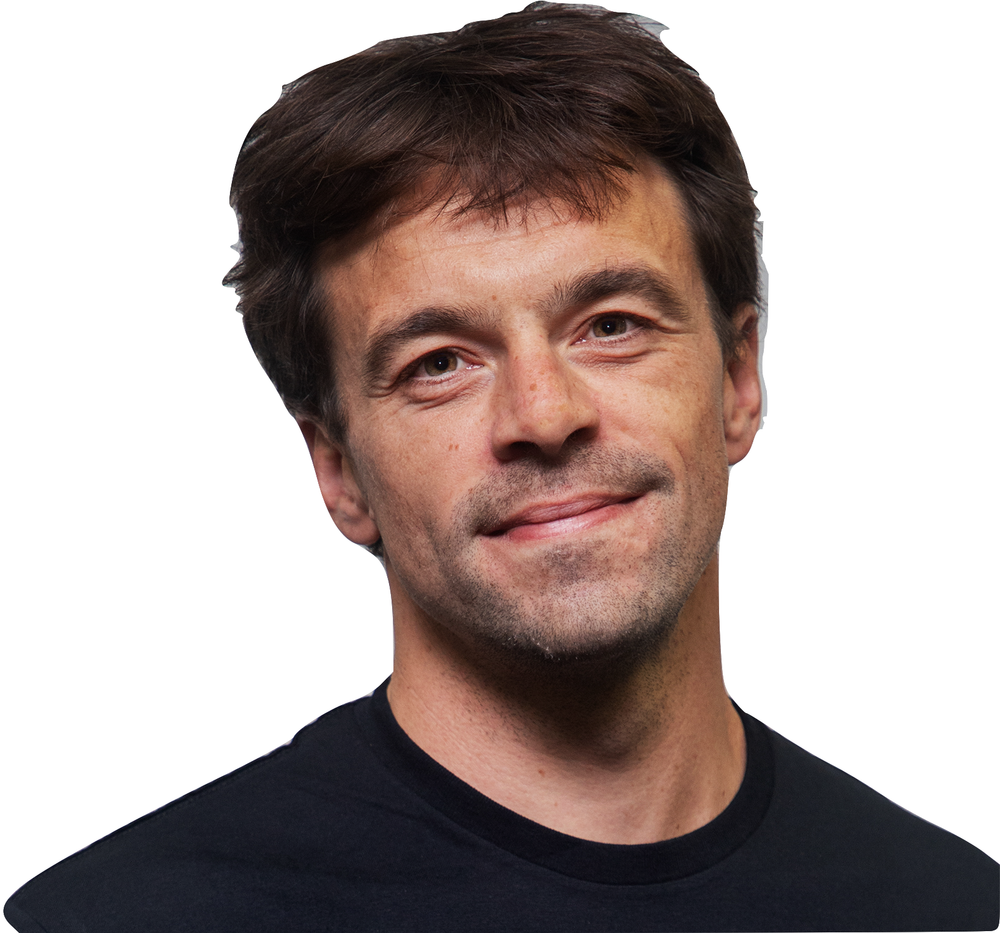
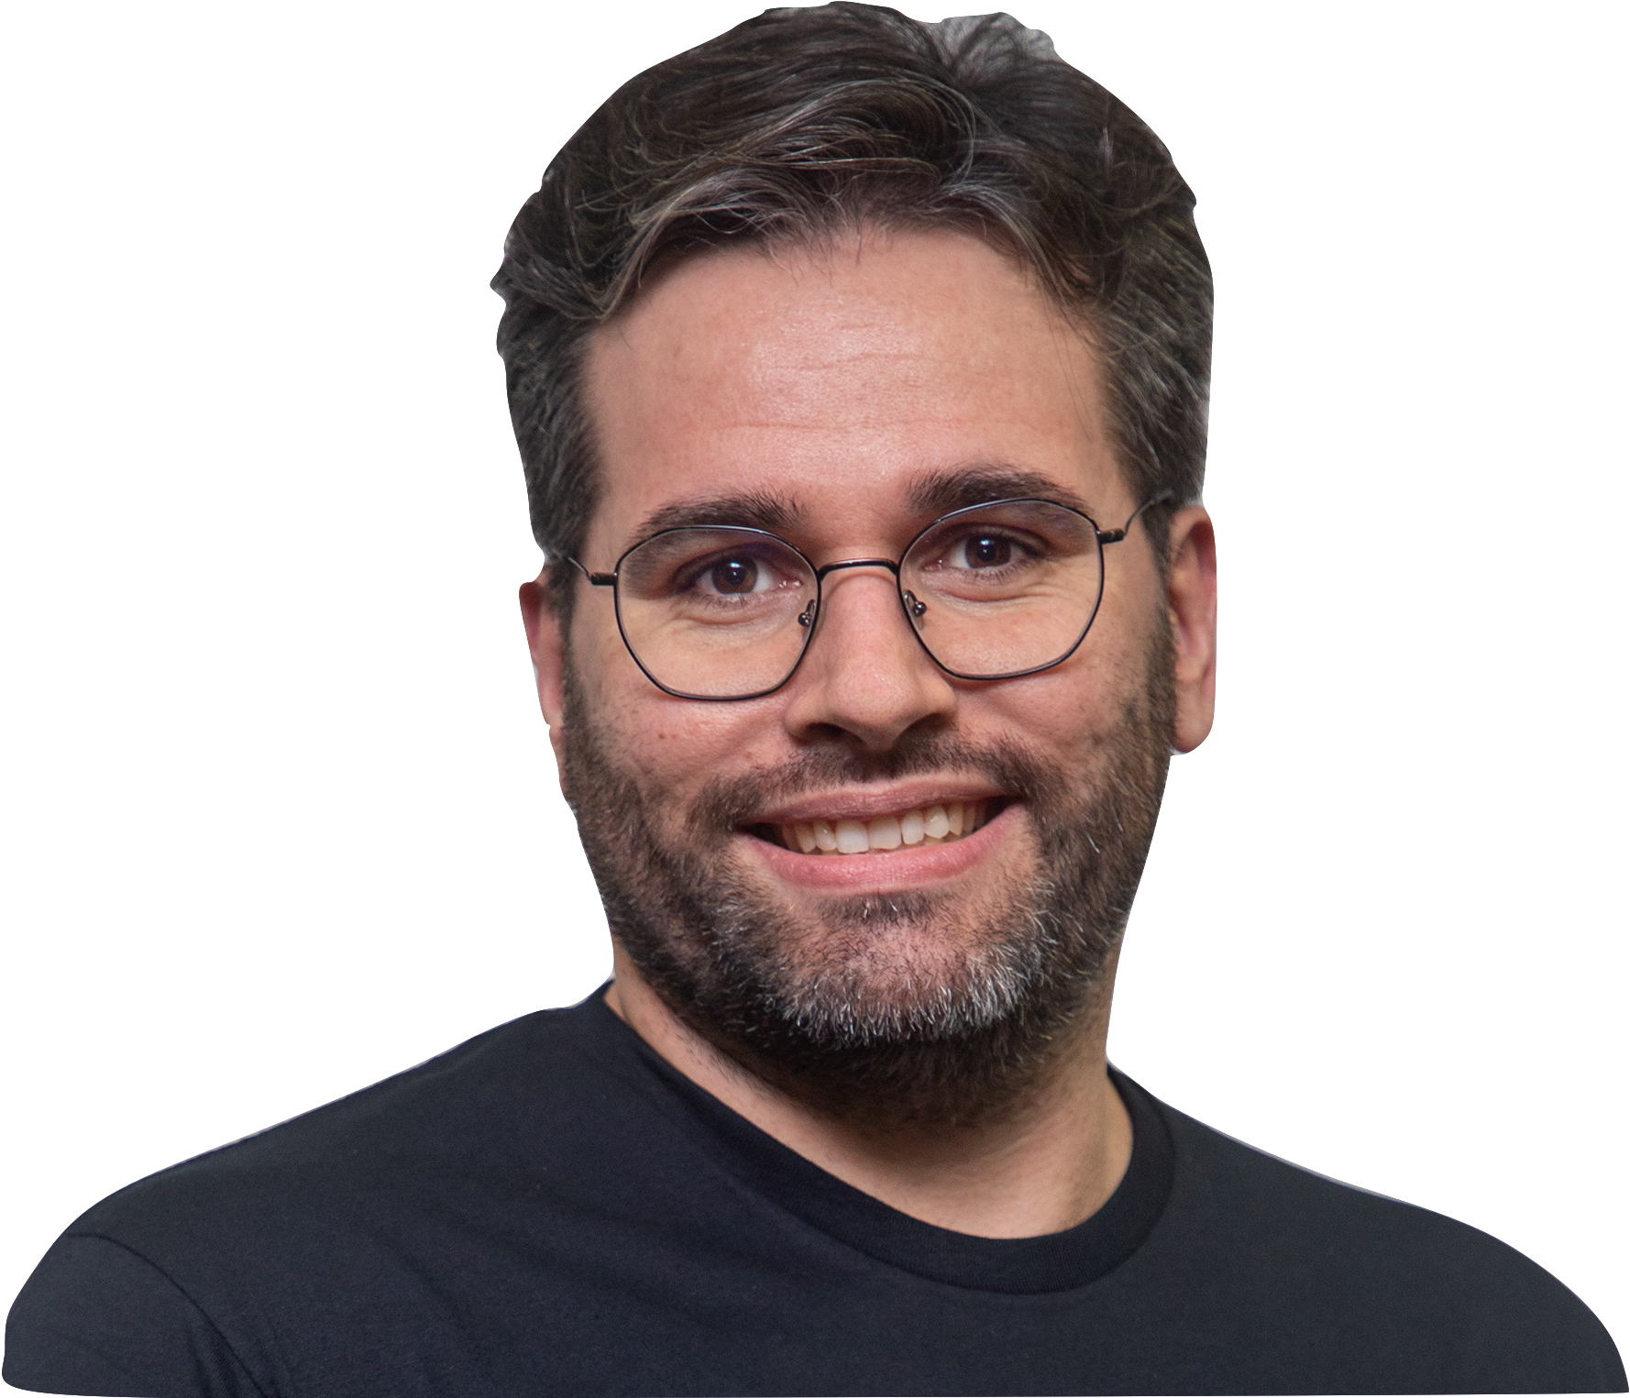
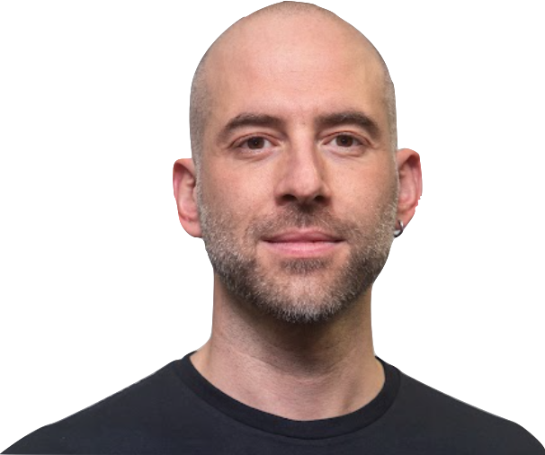
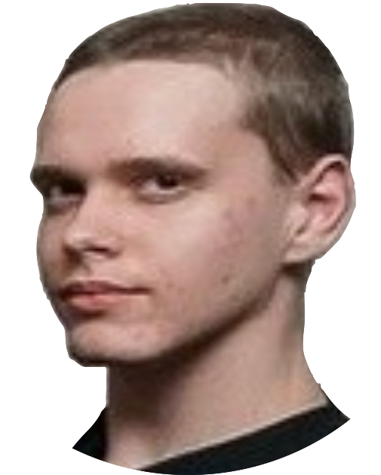
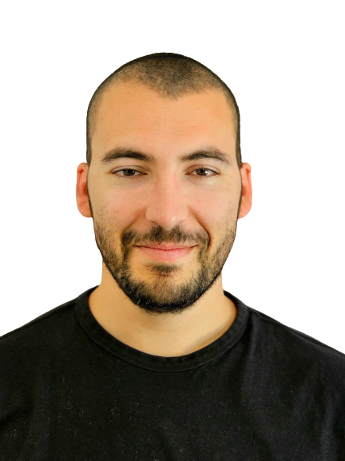
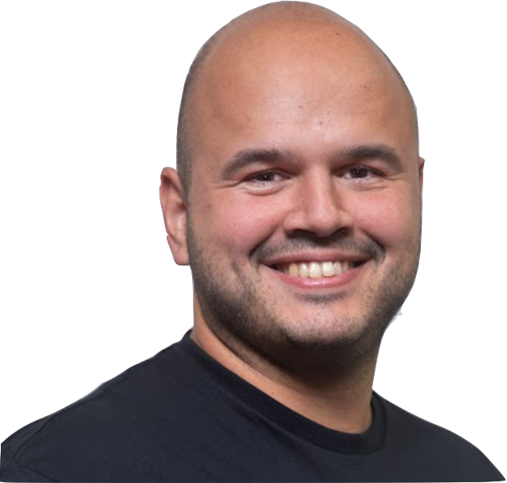

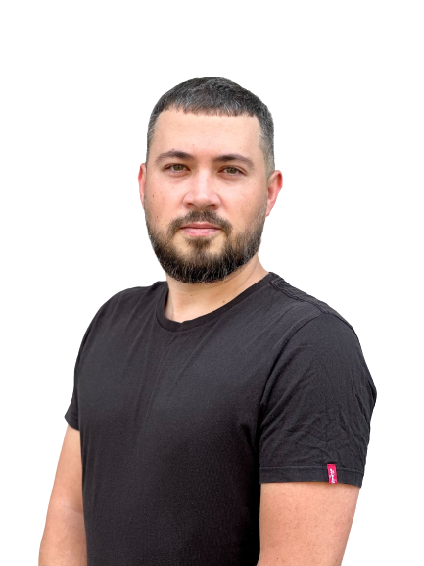
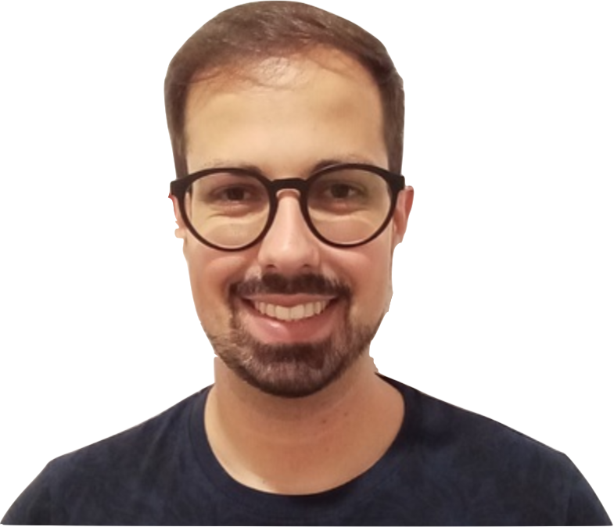
Meet the senior tech team
Matthieu Le Berre
Co-founder, CTO
João Pedro Vieira
Senior Developer
Gonen Eren
Senior Developer
Pavel Khalimov
Senior Developer
Pedro Silva
Senior Engineer in Test
Emanuel Gaspar
Senior Developer
Tiago Pereira
Senior Developer
Viktor Klymenko
Senior Developer

Slide 31
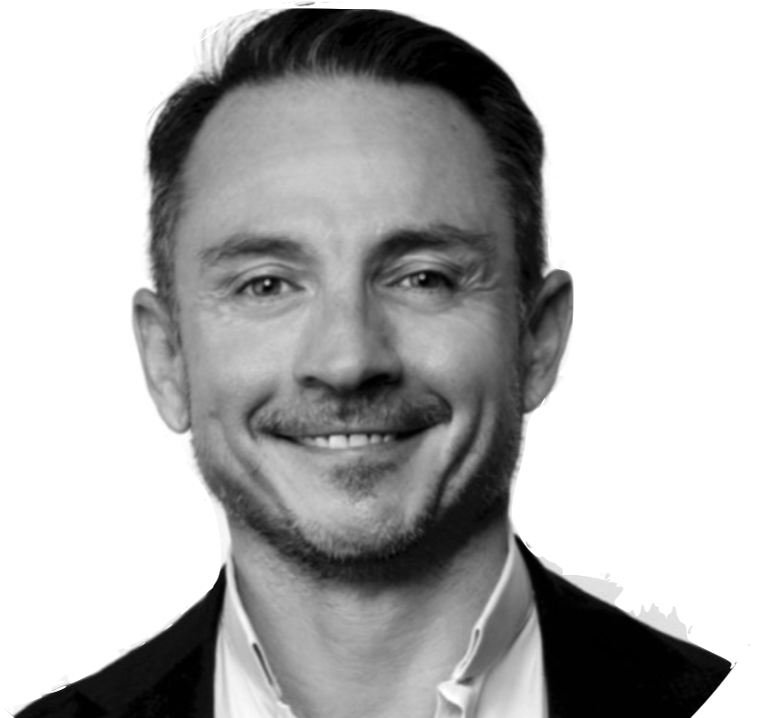
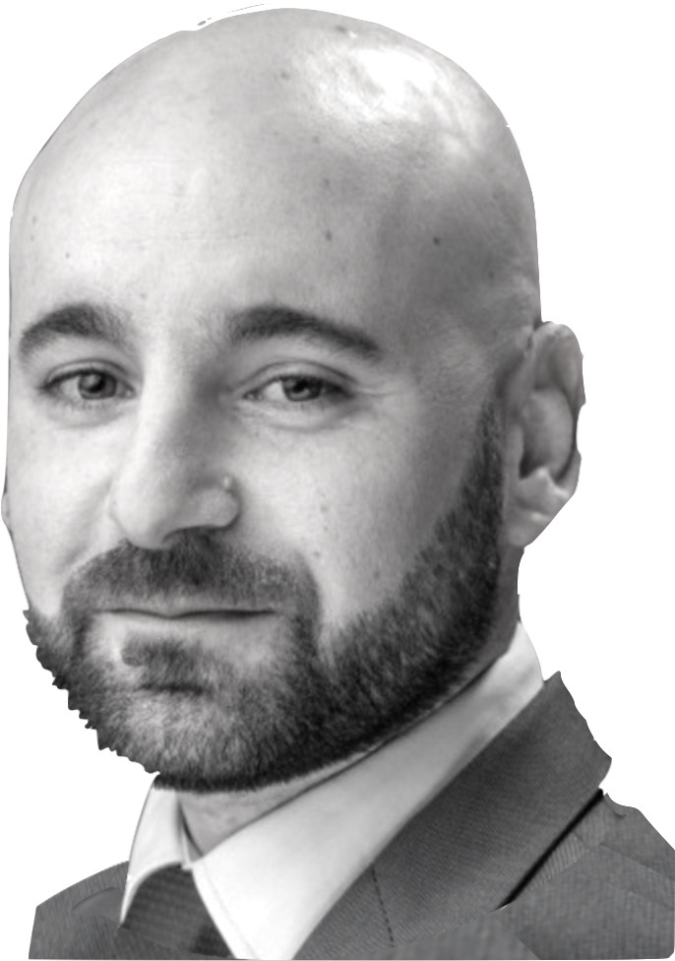
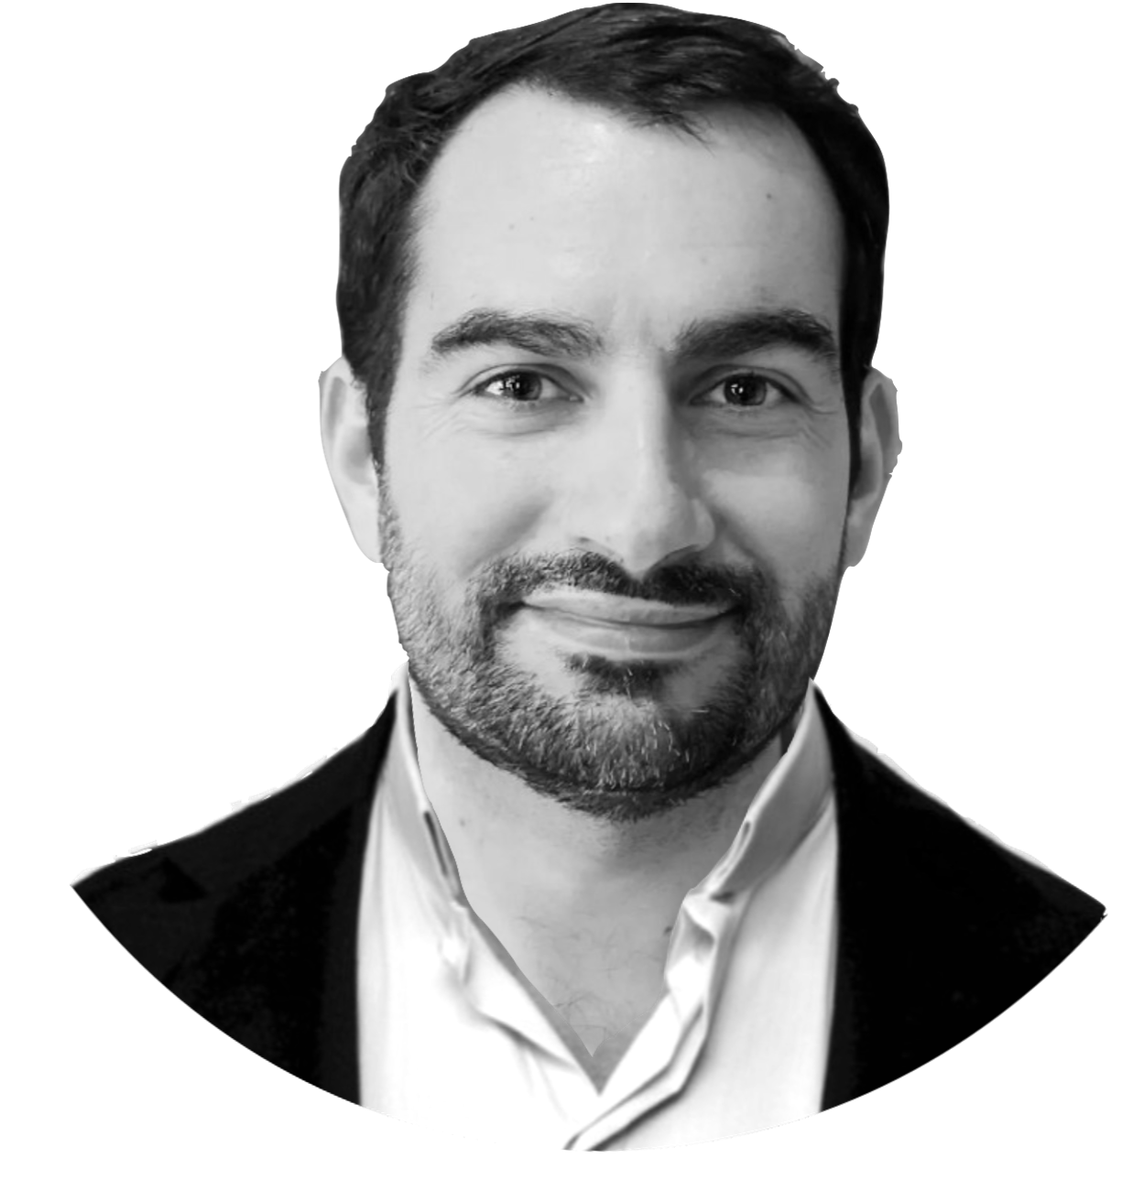
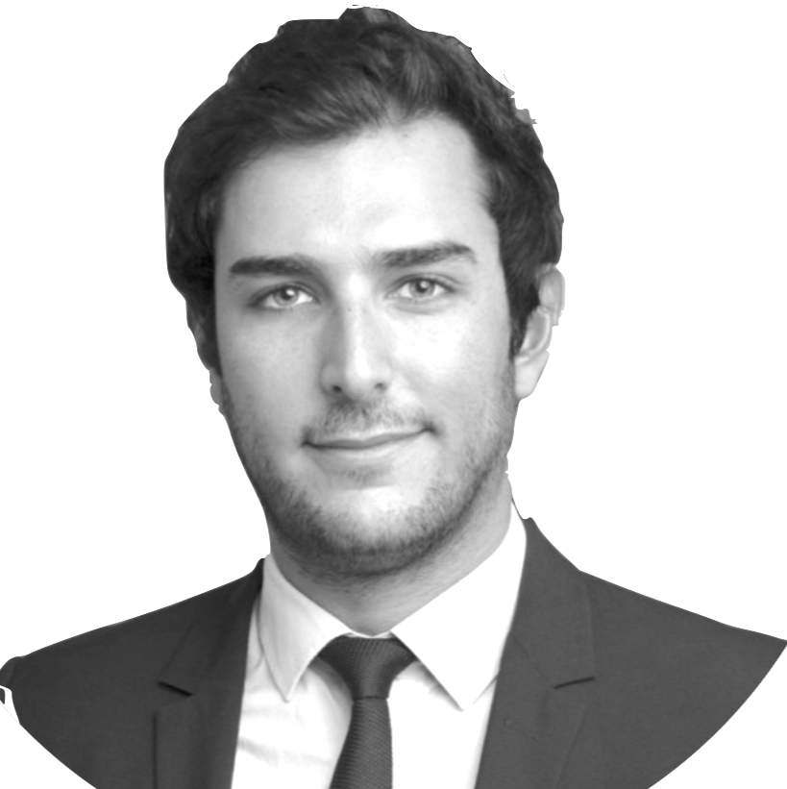
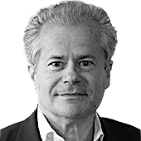
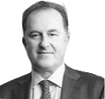
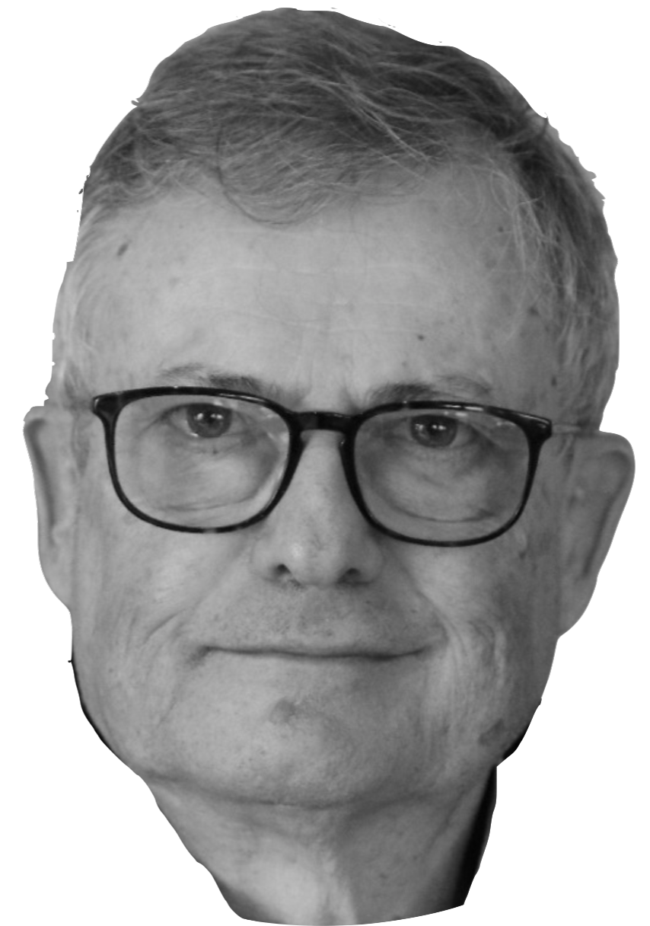

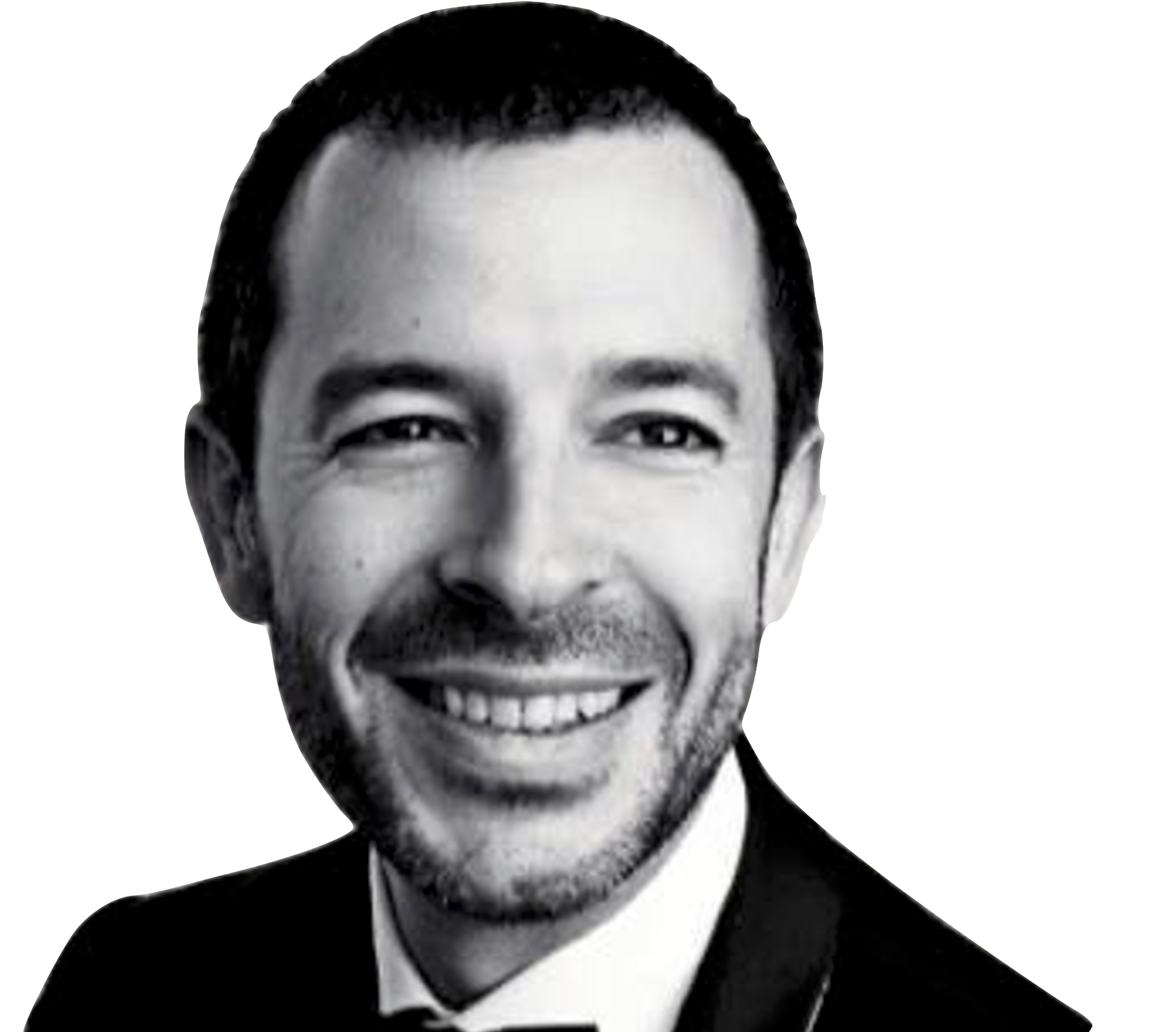
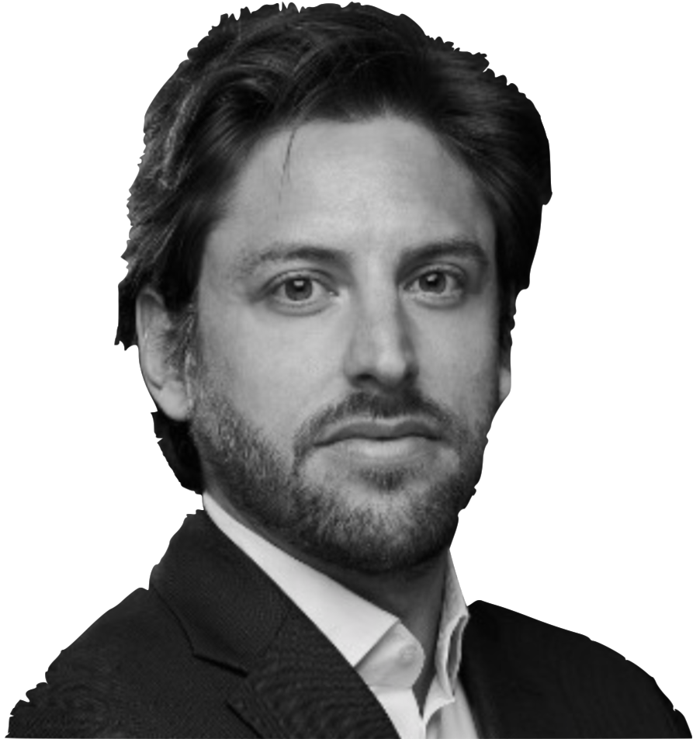
Meet Trakx advisors
Token Sale
Christophe Coutteau
Private Wealth manager
Christophe Barraud
Chief economist @MarketSecurities
Gabriel Rebibo
Co-founder @Atka
Daniel Arroche
Lawyer @ d&a Partners
Trakx Strategic Committee
Jean-Marc Bonnefous
Partner CEO @ Tellurian
Ex BNP Trading
Laurent Seyer
Ex-COO MSCI
ex-CEO Lyxor
Didier Varlet
CEO Cartesia
founder Carr Futures
Didier Seillier
Dir. of Dauphine Incubator
Mathieu Amzallag
M&A @ FinancièreCambon
Stephane Daniel
Lawyer @ d&a Partners

Slide 32
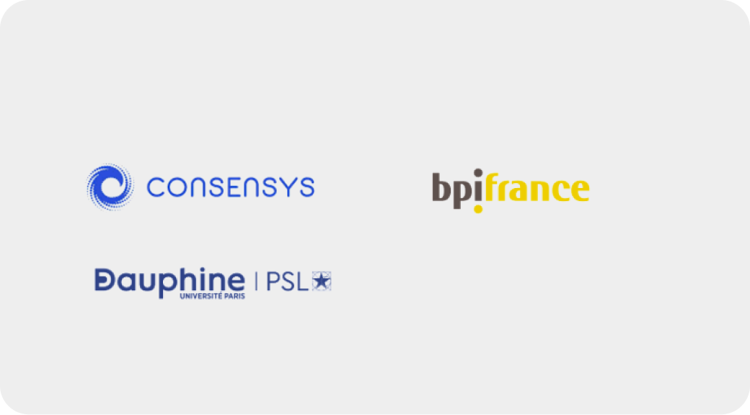
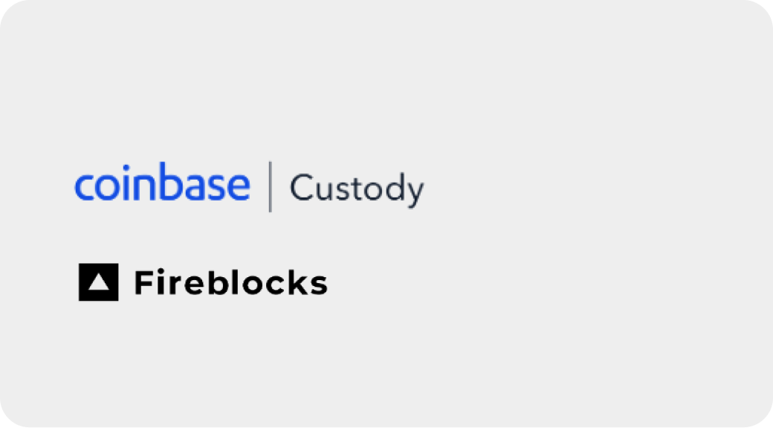

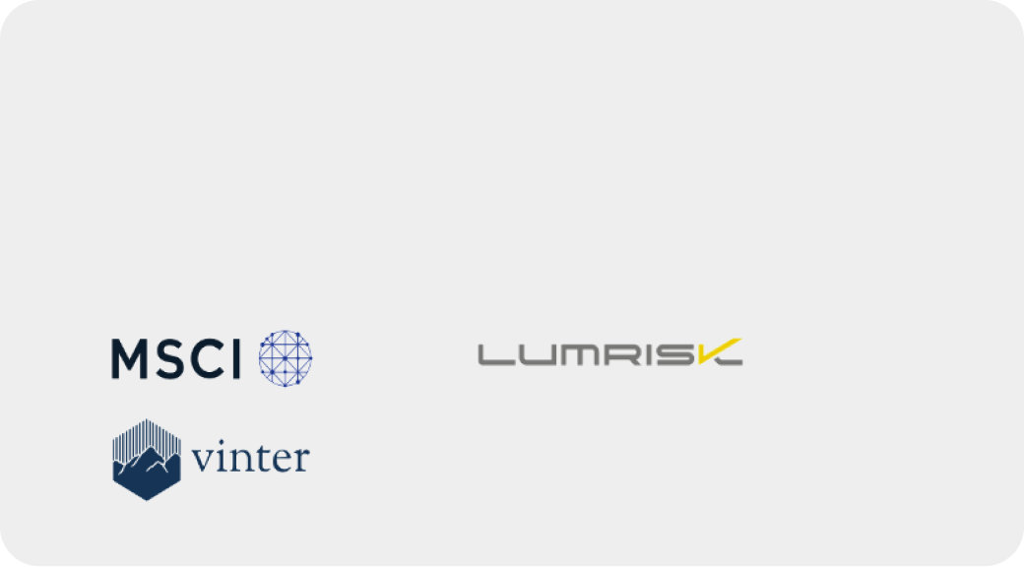
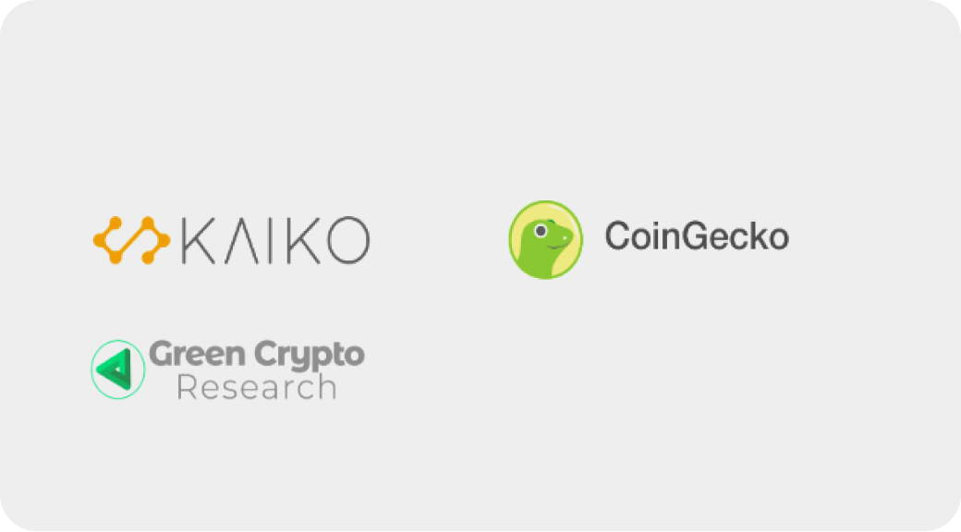

Our ecosystem of partners
Accelerator and investors
Secured Custody
KYC / AML
Index Franchises
Trakx acts in an advisory capacity as an expert on the ongoing evolution of certain themes underlying certain of MSCI’s indexes
Crypto Market Data
Fiat On-Ramp

Slide 33
Trakx timeline
2019
Creation of Trakx SAS, incorporated in France
Incubated at Dauphine University
Seeded and accelerated by ConsenSys
---------------------
Funding from BPI France and reputable Business Angels
Constitution of the strategic committee
Launch the first beta products on trakx.io, then a trading platform dedicated to professional traders
Granted VASP registration with the French Regulator (AMF)
Launch the official web version of the platform
Daily publication of Trakx CTI prices on Lumrisk
Equity fund raising round
Strengthened the core team
---------------------
Daily publication of Trakx CTI prices on Bloomberg
Partnership with MSCI
Partnership with Green Crypto Research
Partnership with Vinter, independent index calculator
Multichannel approach, partnership with top broker dealers
Launch our bespoke solution offering
Two rounds of private token sale
Team grew to 20+ total, including 5 new Senior Developers
First certificate issued with Gentwo on Top Blockchains Index
---------------------
Launch our new branding
Implementation of the retail marketing plan
Enabling retail investors to access Trakx CTIs
Dedicated risk profile strategies
Launched staked products
New digital distribution channels
Prepare the transition to MiCA
Launch more sophisticated products
Push on bespoke solutions
Develop tech-as-a service offering
Expand geographic footprint outside Europe
Further improvement of the UI/UX
Fine tuning of the data mining and trading bots
Mobile app
2020
2021
2022
2023
2024+

Slide 34
Disclaimers
This presentation has been prepared by Trakx and its affiliates (collectively “Trakx” or the “Company”). The information contained in this presentation is subject to changes and/or updates without notice and at the Company’s sole discretion, and should not be construed as a commitment, promise or guarantee relating to the future performance or value of the Company. The information contained herein has been obtained from sources believed to be reliable but Trakx does not represent or warrant that it is accurate and complete. This presentation is provided to you for information purposes only and does not constitute an offer or solicitation to sell and/or acquire crypto assets, shares or securities. It does not constitute or form part of and should not be construed as any offer for sale or subscription of or any invitation to buy or subscribe for any securities not should it or any part of it form the basis of or be relied upon in connection with any contract or commitment whatsoever. Any offer to sell or solicitation of an offer to buy financial instruments may be made solely through definitive offering documents, identified as such, in compliance with the terms of all applicable securities and other laws. Such definitive offering documents, if any, will describe risks related to an investment and will qualify in their entirety the information set forth in this presentation.
Trakx and/or an affiliate, a legal representative, an officer or an employee, together expressly disclaim any and all responsibility for any direct or consequential loss or damage of any kind whatsoever arising directly or indirectly from reliance on any information contained in this presentation, any error, omission or inaccuracy in such document or any action resulting therefrom. This document does not constitute a recommendation to buy or financial advice. It is strictly informational. Do not trade or invest in any tokens, crypto assets, companies or entities based upon this document. Any investment involves substantial risks, including, but not limited to, pricing volatility, inadequate liquidity, and the potential complete loss of your investment. Investors should conduct independent due diligence, with assistance from professional financial, legal and tax experts, on topics discussed in this document and develop a standalone judgment of the relevant markets prior to making any investment decision.
Copyright in this report is owned by Trakx (© Trakx, 2023) - no part of this report may be reproduced in any manner without the prior written permission of Trakx.
TRAKX is a French société par actions simplifiée having its registered office at 10 rue penthièvre, 75008 Paris, registered with the Paris Trade and Companies Register under number 850 626 078, and represented by Allco Ltd, a company based in Malta and registered under number C90184, acting as Chief Executive Officer (Président). TRAKX is a digital asset service provider registered with the Autorité des Marchés Financiers under number E2021-020, providing TRAKX services to registered users. TRAKX contact email address: support@trakx.io
ANY INVESTMENT IN DIGITAL ASSETS IS AN INHERENTLY RISKY INVESTMENT. IF YOU ARE IN ANY DOUBT ABOUT INVESTING, THE COMPANY RECOMMENDS YOU CONSULT WITH YOUR FINANCIAL ADVISOR.

